Slide 1
Victor Valley Community College District
Student focus. Student success.

Slide 2
SOME BASIC FACTS
Established in 1961
Accredited by WASC
Total Enrollment
(2009-2010): 19,439
Full-Time Equivalent
Students (2009-2010):
10,022
BOARD OF TRUSTEES
SUPERINTENDENT/
PRESIDENT
DEPUTY SUPERINTENDENT/
EXEC VICE PRESIDENT
VICE PRESIDENT
ADMIN SERVICES
VICE PRESIDENT
HUMAN RESOURCES

Slide 3
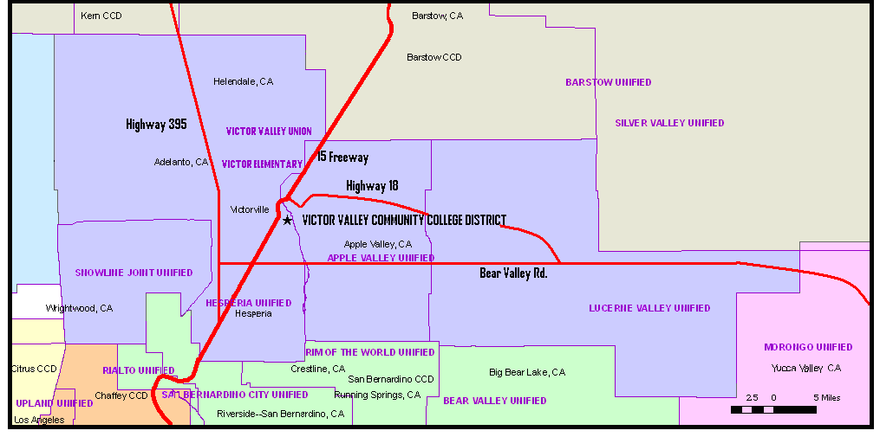
DISTRICT BOUNDARIES
The District is located in the High desert region of California, approximately 90 miles northeast of Los Angeles and 35 miles north of San Bernardino.
Encompassing approximately 1,800 square miles, the District serves nearly 385,000 people in one of largest geographical areas in the State.

Slide 4
FACILITIES
Existing Infrastructure
40 principal buildings
710 rooms
377,209 gross square feet of building space
485,244 gross square feet of outside space
Future Developments ($297.5M general obligation bond)
Public Safety Training Center—Educational complex in partnership with Apple Valley Fire Protection District
Workforce Development Job Training Center—Includes a Business Academy and a Health Sciences Academy

Slide 5
STAFFING
On average, VVCCD employs nearly 800 individuals each year.

Slide 6
ENROLLMENTS
Projected enrollments are shown in boxes.
The pattern of increased full-time equivalents and decreases in unduplicated headcounts indicates students are taking higher loads—that is, they are more committed, focused, and pursuing specific educational/career goals.

Slide 7
PROGRAMS OF DISTINCTION
“BRIDGE” PROGRAM—In an effort to improve student transition from high schools to colleges and universities, area superintendents, board members, administrators, principals, and other educational leaders created a program known as “Bridge.” This program utilizes senior advisory teachers to instruct students on how to navigate the college’s financial aid, placement, enrollment, and registration processes.
HIGH CALIBER NURSING PROGRAM—Consistently posts high retention rates (88%), graduated 758 students over the last five years, and placement rates on the National Council Licensure Examination-Registered Nursing (NCLEX-RN) have consistently been above 85%.
MODEL UNITED NATIONS—A competitive exercise that gives our students the opportunity to represent countries through the world in problem-solving exercises. For the last five years, VVCC students have been awarded the two top awards that a delegation can receive at the annual conference in New York city.
PERFORMING ARTS CENTER—Having completed a 20,563 square foot addition to the Performing Arts Center, this venue continues to represent the cultural center of the High Desert region.

Slide 8
GRADUATES
Annually, VVCC graduates over 1,000 students with an associate’s degree.
Decrease in certificates in 2008-09 due to change in legal requirement to formally report
low-credit certificates—those are still conferred but not reported to State.

Slide 9
Victor Valley Community College District
18422 Bear Valley Road
Victorville, California 92395
www.vvc.edu

