Slide 1
Roles and Responsibilities for Grants & Restricted Funds Management

Slide 2
VISION AND MISSION STATEMENTS
Vision
Victor Valley Community College District uplifts the diverse communities we teach and serve by promoting educational excellence, enhancing local prosperity, and ensuring environmental leadership.
.
Mission
The mission of Victor Valley Community College is to:
Cultivate intellectual growth, social responsibility, environmental stewardship, cultural enrichment, and economic development.
Create exceptional and accessible lifelong learning opportunities that afford students within our expanding communities the attainment of knowledge and skills necessary for success in the global economy.
Embrace difference in our communities by integrating their wealth of multicultural knowledge and wisdom into a cohesive and resourceful learning environment for all.
Inspire innovative teaching and service with imaginative uses of collaboration and technology, fostering vibrant programs that are measurably effective in addressing student learning and community needs.
Empower each student to learn by modeling academic integrity, democratic citizenship, and meaningful contribution to society.

Slide 3
2018-19 GRANT LIST
Federal Grants:
CTE Transitions
FSEOG
TANF
Federal Work Study
Perkins 1-C
PELL
Upward Bound
Veterans
BLM Seed Grant
WIOA

Slide 4
2018-19 GRANT LIST
State Grants:
Student Success and Support Program (SSSP) Credit/Non-Credit
Student Equity Plan (SEP)
Basic Skills Initiative – These are now SEA
Student Fin. Aid Admin. (SFAA)/BFAP
AEBG – Data and Accountability
ISPIC Makers Space (SWP)
DSN – Rancho Santiago
Pre-Apprenticeship Grant
Apprenticeship Grant
Nursing Education
Equal Employ Opportunity (Staff Diversity)
Prop 39 Energy Project
Song Brown
Physical Plant/Instructional Support
Lottery
AFT (PT Faculty Compensation)
Basic Skills – Student Learning Outcomes (SAM)
Mental Health Program
Strong Workforce – Local (Round 1)
Strong Workforce – Local (Round 2)
Strong Workforce – Local (Round 3)
Strong Workforce – Local (Round 4)
Strong Workforce – Regional (Round 1)
Strong Workforce – Regional (Round 2)
Strong Workforce – Regional (Round 3)
Strong Workforce – Regional (Round 4)
Innovation & Effectiveness Grant
Campus Security & Sexual Assault
Hunger Free Program
Veterans Resource Center I
Veterans Resource Center II
Classified Professional Development
EOPS
CARE
CALWORKS
AEBG
FA Technology
DACA- Dreamers
SSCG
Access – fka DSPS
TANF- CDC
Re-Entry
NEXTUP- CAFYES
DSN- Adv Tech & Logistics
Guided Pathways
DSN – Business
DSN - Chabot

Slide 5
2018-19 GRANT LIST- Continued
Local Grants:
Student Transportation
Child Dev Training Consort
Nursing Prep Tests
San Manuel Grant
Waste & Recycling Corrections
B of A - Better Opps for Troops / BOOTS
Public Safety Training Center
Weekend Nursing
Fire Tech Materials
Admin of Justice Materials
Const & Mfg Tech – Corrections
ASE Cert - Corrections
Construction Tech Materials
Foundation – Miscellaneous Pass Through Grants
Dr Prem Reddy Grant
CSUSB Crest Grant
Desert Valley Hospital Support
So Cal Edison STEM Grants
National Student Nursing Association
Water Removal/Recycle-corrections
WIB Assoc Nursing Program
Wells Fargo VA Resource Center
FCC/BAR Smog Referee Lease Auto
Walmart VA Resource Center Grant
Community Service Community Services - Phlebotomy
Community Service - Fees
Community Service – Fire Tech
Community Services – Auto Seminars
Campus Police: Fingerprinting
Contract Education
Contract Ed - Nursing
Contract Ed- CSRI
Contract Ed - Victor Elem School Dist
Contract Ed- General Atomics
Puente
Job Fair
Kaiser Grant
Citations
Planetarium
Parking and Security
Catering
Ram Rock Café
Faculty/Staff Dining
EMT Materials
West Ed Early Start
Faculty Mini Grants
Rio Tinto AG Grant

Slide 6
POST-AWARD
We received the award! Now what?

Slide 7
FISCAL OFFICE SERVICES RESPONSIBILITIES
The Fiscal Services Office is responsible for the following areas:
Grants and contracts revenue streams from federal, state, and local funding sources.
The office of record for all grant agreements, subaward agreements, and service contracts.
Post-award administration:
Budgeting - establish budget codes; provide salary and benefit information; provide monthly budget reports; conduct quarterly/mid-year budget review; process budget transfers/revisions; provide annual budget worksheets and enter budgets
Accounting – process accounts payable, procurement, travel, accounts receivable, budget and expenditure transfers, service contracts (before work is performed), equipment inventory and ensure financial controls are in place
Reporting – review financial reporting on program expenditures, cost share compliance as required by awarding agency, reports prior to submission, and certify on reporting website
Record Retention – maintain grant files for up to three years after final reports have been submitted

Slide 8
FISCAL SERVICES OFFICE RESPONSIBILITIES - Continued
Provide grants and administrative procedures training
Provide the tools necessary to effectively manage the post award financial functions of the grant award(s)
Provide training on Financial 2000 (F2K) and EDU Reports
Set up budget codes for the grant award
Maintain contracts/agreements
Process expenditure and budget transfers
Approve personnel paperwork to ensure availability of funds and verify account number
Bill per the new FI$Cal billing procedures/bill pass through entities
Maintain the Categorical Grants Calendar and send reminders of due dates to all managers

Slide 9
PROJECT DIRECTORS AND PROGRAM SUPPORT STAFF RESPONSIBILITIES
Read award documents carefully and pay close attention to terms and conditions of the award (ex: project period, allowable expenditures, Non-allowable expenditures, reporting deadlines).
Submit award agreements, Grant Award Notices (GANs), or contracts to FISCAL Services. Also provide Fiscal Services with copies of the allowable/Non-allowable expenditure lists and reporting dates
Submit Budget Augmentation/Budget Revisions to FISCAL Services
Spend funds in a timely manner – not leaving expenditures to the end of the year
Directors/grant managers should be responsible for making sure there is budget prior to spending, if not request budget transfers PRIOR to submitting requisition
Make sure budget transfers are entered into the Chancellor’s Office site, request budget transfers from the program managers – BEFORE spending. Send approvals to Fiscal

Slide 10
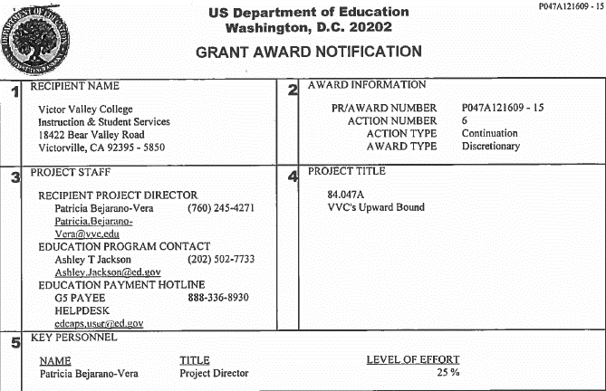
SAMPLE GRANT AWARD NOTIFICATION (GAN)

Slide 11
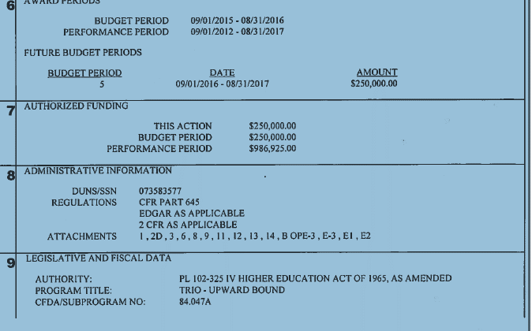
SAMPLE GAN - Continued

Slide 12
Sample alternate GAN (email from Chancellors Office)

Slide 13
Sample alternate GAN (email from Chancellors Office)

Slide 14
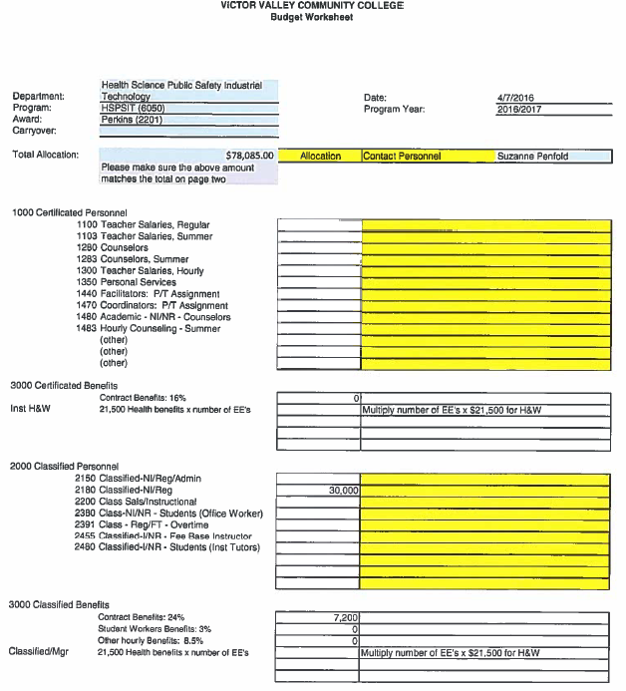
SAMPLE BUDGET WORKSHEET

Slide 15
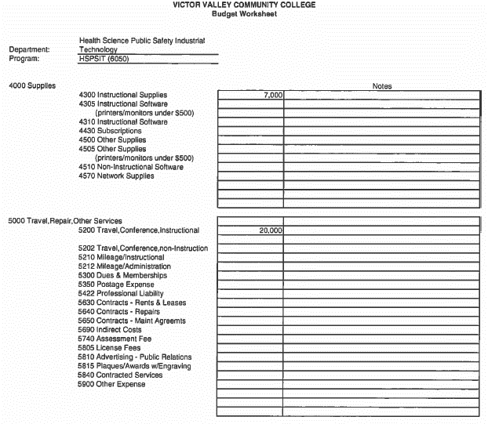
SAMPLE BUDGET WORKSHEET– Continued

Slide 16
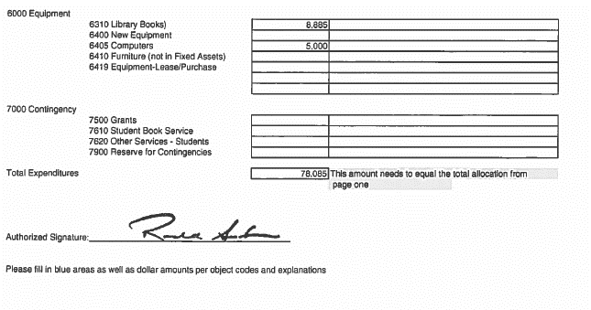
SAMPLE BUDGET WORKSHEET– Continued

Slide 17
PROJECT DIRECTORS AND PROGRAM SUPPORT STAFF RESPONSIBILITIES- Continued
Review work-plan, deliverables, objectives, and budget needed to implement grant activities
Implement project and conduct program activities as detailed in the award terms and conditions, or GAN
Ensure no conflict of interest is involved in the project
Be informed of local, state, and federal laws - Be good stewards of grant funds!
Provide Fiscal Services with copies of GAN, allowable expenditures, non-allowable expenditures, grant requirements, RFP/RFA, and all related documents
Provide Fiscal Services with copies of reports that were submitted to respective agencies

Slide 18
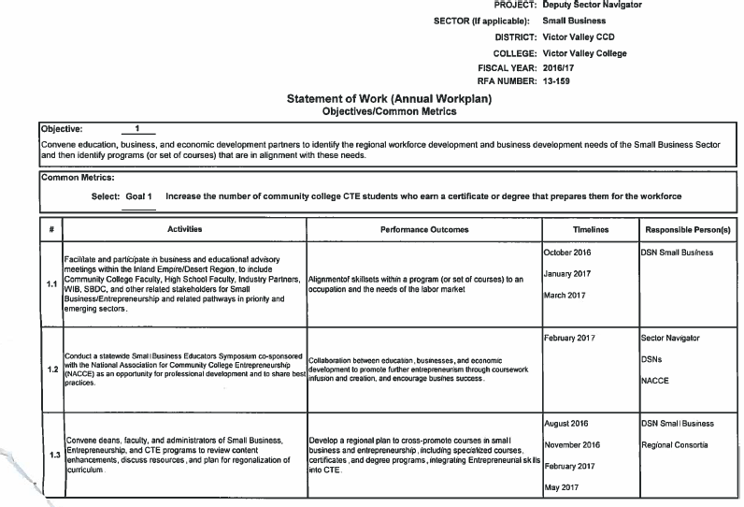
SAMPLE WORKPLAN (State Grant)
Need to look for this!!!!

Slide 19
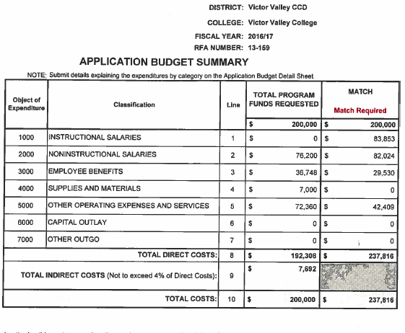
SAMPLE BUDGET (State Grant)

Slide 20
PROJECT DIRECTORS AND PROGRAM SUPPORT STAFF RESPONSIBILITIES - Continued
Monitor all budget expenditures to ensure fiscal compliance and alignment with approved budget, funding agency requirements, and district policies
Program expenditures must be allowable, allocable, and reasonable
Submit Expenditure Transfers and/or Budget Transfers/Revisions as necessary WITH appropriate supporting documentation
Must have program managers approval on all budget transfers/requests to move expenses
*Note: changes in project scope, objectives, key personnel, or major budget reallocations (ten percent of budget line items) need prior agency approval – if there is movement between major objects those need approval from the project manager as well

Slide 21
BIDDING PROCEDURES MATRIX
VICTOR VALLEY COLLEGE
CONSTRUCTION PROJECTS (per UPCCAA) | Min Quotes | Board Action | Prevailing Wage | Bid Bond | Payment Bond | Liability Insur. Cert | Auto Insur. Cert | Remarks
Projects under $1,000 | 1 | SABR | N | N | N | Y | Y | PO, RFP, or proposal
Projects $1,000 to $14,999 | 2 | SABR | Y | N | N | Y | Y | PO, RFP, or proposal
Projects $15,000 to $63,999 | 2 | SABR | Y | N | N | Y | Y | PO, RFP, or proposal
Projects $64,000 to $90,199 | 2 | BAP | Y | Y | Y | Y | Y | PO, RFP, or proposal
Projects $90,200 and larger | Bids | BAP | Y | Y | Y | Y | Y | RFP, Existing Bid or Formal Bidding
NON-CONSTRUCTION Equipment, Materials, Services, Etc
Purchases of $0 to $10,000 | 1 | N/A | N | N | N |  |  | 1 quote required, 2 recommended
Purchases of $10,001 to $20,000 | 2 | N/A | N | N | N |  |  | 2 written quotes (catalog/internet OK)
Purchases of $20,001 to $63,999 | 2 | N/A | N | N | N |  |  | 2 written quotes (catalog/internet OK)
Purchases of $64,000 to $90,199 | 3 | N/A | N | N | N |  |  | Informal RFQ w/ 3 written quotes
Purchases of $90,200 or more | Bids | BPA | N | N | N | Y- contractor | Y- contractor | Formal RFP, specs, advertisement, Bid Bond 5% optional by CEO
SABR = Superintendent Approval and Board of Trustees Ratified
BAP = Board of Trustees Approval prior to commitment

Slide 22
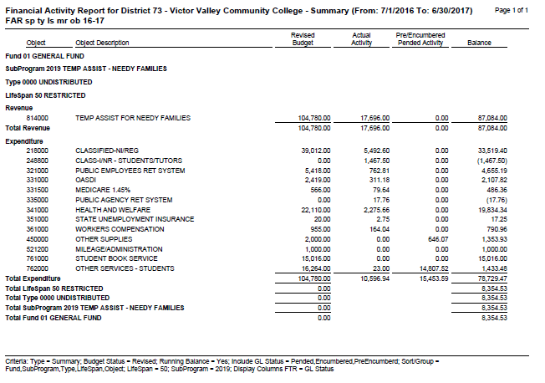
SAMPLE FINANCIAL ACTIVITY REPORT

Slide 23
PROJECT DIRECTORS AND PROGRAM SUPPORT STAFF RESPONSIBILITIES - Continued
Meet regularly with program personnel to assess and report on progress of the program
Notify Fiscal Services of ALL reporting deadlines
Complete quarterly and annual performance/progress reports as required by funding agency. Submit Reports to be approved by component administrator(s), and allow ample time for review before submission
Complete quarterly and annual financial reports as required by funding agency. Submit Reports for approval By component administrator(s) audited by Fiscal Services, certified and submitted on time. Provide signed copies to Fiscal Services .

Slide 24
PROJECT DIRECTORS AND PROGRAM SUPPORT STAFF RESPONSIBILITIES - Continued
Maintain detailed and accurate records of all program activities (progress/performance, finances, participant information, inventory of equipment, and any other relevant information)
Grant employees MUST complete Time & Effort (T&E) Certification Forms monthly and account for 100% of their salary. Send copies to the Fiscal Services Office. These must be signed off my each Program Manager. These forms are monthly from the 1st to the 31st (if applicable)
*NOTE: If an employee is classified or certificated and works only for ONE program they can submit their T&E forms every 6 months.

Slide 25
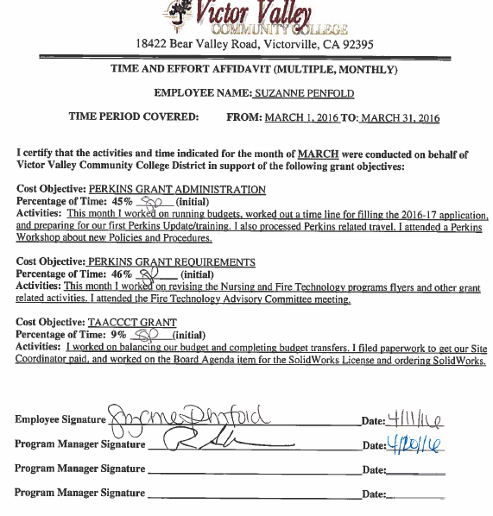
SAMPLE TIME AND EFFORT FORM
xxxxxxxxxxxx
xxxxxxxxxxxxxxxxxx

Slide 26
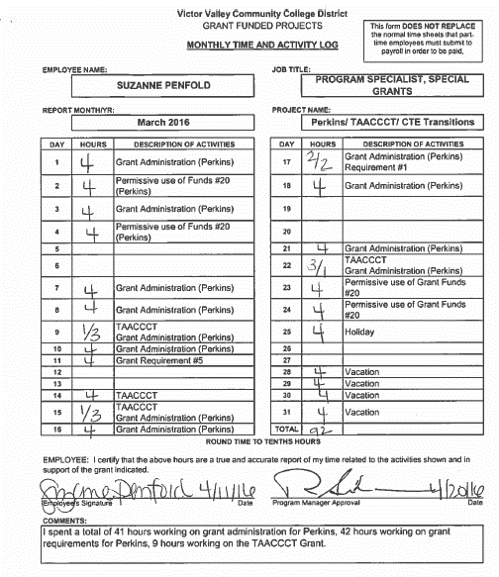
SAMPLE TIME AND EFFORT - Continued
xxxxxxxxxx
xxxxxxxxxxxxxx

Slide 27
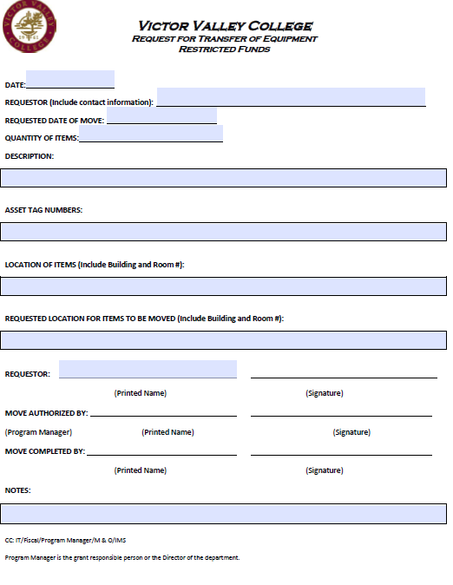
EQUIPMENT TRANSFER SHEET

Slide 28
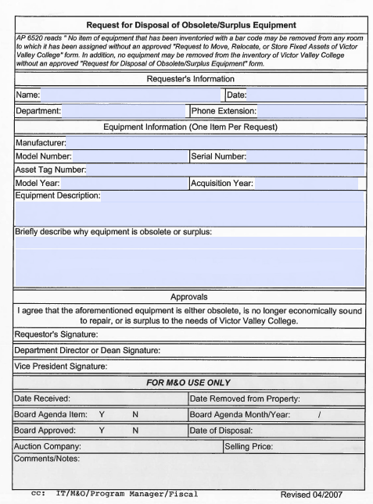
DISPOSAL OF OBSOLETE/SURPLUS EQUIPMENT

Slide 29
GRANT CLOSEOUT
PROJECT DIRECTORS AND PROGRAM SUPPORT STAFF RESPONSIBILITIES -Continued
Prepare and submit all performance, and other reports required within 90 days of completion of the grant – or due date if sooner
Dispose of or return government-furnished equipment/supplies if necessary. Equipment is $5,000.00 or more in remaining value
Submit final paperwork for grant closeout to Fiscal Services (final progress and financial reports; review expenditures to resolve any outstanding items or compliance issues prior to closeout)
Retain grant records for at least three years after final report has been submitted
Assist in providing the necessary information/data requested during audits

Slide 30
Summary of Roles and Responsibilities
POST-AWARD PHASE
Task | Grant Project Director | Fiscal Representative | Dean | Vice President | President | VVC College Foundation
Obtain Grant Agreement | Review and provide contract to Admin. Svs. | E-file agreement, Review | Review | Review | Review | Review; Provide partnership agreements/RFP/ RFA if necessary
Budget Augmentation Form: New and Continuing budgets | Prepare for submission; Provide Supporting Docs | Review and process into F2K | Review and sign | Review and sign |  | Provide partnership agreements/RFP/ RFA if necessary
Personnel Paperwork: New Hires, Special Project Agreements, budget/position changes, | Work with HR, complete necessary HR forms, Prepare for submission, monitor deliverables, track submission of final report | Verify funding; Review and Sign | Review and Sign | Review and Sign | Review and Sign (as necessary)
Project Implementation | Implement project as detailed in terms and conditions of award | Review budget | Monitor and meet with program staff as needed | Monitor and meet with program staff as needed
Monitor Program Activities and Expenditures | Review budget reports monthly; monitor subrecipients; assess progress | Provide monthly and quarterly expense reports. Provide Excel/PDF reports as needed | Review | Review

Slide 31
Summary of Roles and Responsibilities
Summary of Roles and Responsibilities - Continued
POST-AWARD PHASE
Task | Grant Project Director | Fiscal Representative | Dean | Vice President | President | Advancement and Development/ Foundation
Budget Revisions and Transfers | Prepare for submission/ Approve | Audit and process into F2K | Review and sign
Expenditure Transfers | Prepare for submission/ Approve | Audit: Provide backup for salary related transfers | Review and sign
Time and Effort | Submit to Dean/VP | Receive copy only – review, audit | Review
Reports (Program/Progress) - Periodic (Quarterly, Annual) | Gather data and prepare for submission prior to deadline. | Reviews and certifies to reporting agency | Review all report data prior to submission to funding agency
Reports (Fiscal) - Periodic (Quarterly, Annual) | Gather data and prepare for submission prior to deadline. Input data by funding category | Audit and troubleshoot. Download to PDF/Excel. Submit/Certify Reports as necessary | Review all report data prior to sending to Fiscal for submission to funding agency | Sign as necessary | Sign as necessary

Slide 32
Summary of Roles and Responsibilities
Summary of Roles and Responsibilities - Continued
CLOSE OUT PHASE
Task | Grant Project Director | Fiscal Representative | Dean | Vice President | President | VVC College Foundation
Final Reports | Prepare for submission within 90 days of completion. Provide supporting documentation for review | Audit; Submit/Certify Reports at necessary | Review all report data prior to sending to Fiscal for submission to funding agency | Sign as necessary | Sign as necessary
Dispose of or return equipment | Prepare for disposal of Program equipment. Maintain inventory records | Work with Project Director. M&O, IT and IMS to appropriately dispose of equipment | Review and approve disposal form | Review
Record Retention | Maintain necessary program records for annual audits, and retain for at least 3 years after final reports have been submitted | Maintain financial records for annual audits, and retain for at least 3 years after final reports have been submitted

Slide 33
GRANTS TEAM
Fiscal Services:
Office Location:
Building 10A
Staff:
Pearl Bandringa – x 2680 pearl.bandringa@vvc.edu
Lorie Henning – x 2715 lorie.henning@vvc.edu
Marie Vidana-Barda – x 2286 marie.vidana-barda@vvc.edu

Slide 34
Take Aways/Reminders
Spend money throughout the year – don’t wait until the end of the year
Review all of your requests, hiring forms, etc for the correct account strings
Get all of your information to FISCAL in a timely manner so we can review and process before the deadlines.
Travel needs multiple approvals now, get the authorizations in with extra time so everyone can process.
All contracts/purchase agreements, etc must be signed by the President. They must go to the Board if $250.00 or greater.
Budget managers approval is required for all requisitions, budget transfers, journal entries, hiring forms and increases in amounts or hours for hiring forms. Basically anything that needs funds from a budget needs the budget managers approval prior to processing.
Everything must be reviewed by FISCAL before submitting to reporting agencies.
FISCAL gets copies of all restricted program reports, regulations, allowable /non-allowable expenditures, etc annually or when changes happen
If in doubt – ASK

Slide 35
Thank you!
Q & A

