Slide 1
Most Frequently Asked Questions
By: Hazina Williams
Student Services Lab

Slide 2
When do classes start?
Fall classes start on August 31 and end on December 19

Slide 3
How do I get started at VVC?
The first step is to apply to the college. You can do so by going to our main school website (www.vvc.edu) and clicking apply at the top right of the page or by clicking https://www.opencccapply.net/gateway/apply?cccMisCode=991
Once you apply it will take between 2-3 business days for us to process it, you will then receive a “Welcome” email with your student username and student ID
If you have any problems with this process please contact the Student Services Lab at 760-245-4271 ext. 2453 or 2826

Slide 4
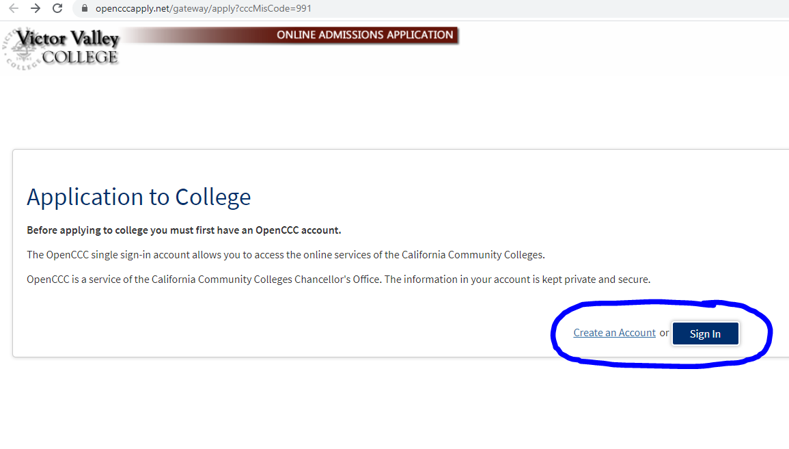
How do I get started at VVC Cont.
Step 1:
Click Apply
Step 3: Click Sign in if you already have an account or create an account if you have never applied to a California community college
Step 2: Scroll down and click Apply Now

Slide 5
Do I need anything to complete the application?
You will need your social security number (if applicable)
High school or college dates attended (can estimate if not sure)

Slide 6
I tried to apply and it says that I already have an account. What do I do?
Every community college in California uses the same application website. If you have applied anywhere in California you already have an account even if you never attended.
You can retrieve your username/password by using your email or security questions. *Remember this information will be from when you first applied, not presently*
If that does not work then you will need to contact OpenCCC at
1-877-247-4836 and they can reset your information. If they are able to verify you over the phone then you can apply the same day if not then it can 1-2 days before you are able to apply.

Slide 7
I have applied, what are my next steps?
Here are the steps to enrollment along with contact numbers should you need assistance with any step
Step ONE: Apply for Admission Online (call 760-245-4271 ext. 2453 or 2826)
Step TWO: Financial Aid (call 760-245-4271 ext. 2277 or 2453)
Step THREE: Set Up WebAdvisor Account (call 760-245-4271 ext. 2740 or 2453 or 2826)
Step FOUR: Student Orientation (call 760-245-4271 ext. 2740 or 2453 or 2826)
Step FIVE: Complete Placement Survey (call 760-245-4271 ext. or 2752 or 2453)
Step SIX: Advisement ( Educational Plan ) (call 760-245-4271 ext 2296 or 2531)
Step SEVEN: Register For Classes (call 760-245-4271 ext. 2740 or 2453 or 2826)
Step EIGHT: Pay Fees & Get Student ID Card (call 760-245-4271 ext. 2370 for fees and
2278 for student ID)

Slide 8
I received the welcome email but I do not know what my password is?
Your password for Webadvisor, Canvas, Student Email, Navigate and the Library login is your birthday in the following format Mmddyyyy (i.e. Jun011995)
If you need assistance you can contact the helpdesk at 760-245-4271 ext. 2740
*When signing in please remember that your username is all lowercase and only the first letter in your password is capitalized. Also you will need to use either google chrome or Firefox web browsers when accessing the above portals*

Slide 9
How do I setup my Webadvisor?
Go to the main school website at www.vvc.edu and click Webadvisor on the top right hand side.
Click “login” at the top right hand side. Your username is what was sent to you in the welcome email and the password is your default password of your birthday (i.e. Jun011995)
Click the blue rectangle that says “students” and you will see your main Webadvisor page.
This is where you can check your financial aid status and pay your student fees as well as complete your placement survey (formally known as the assessment test) and your online orientation.

Slide 10
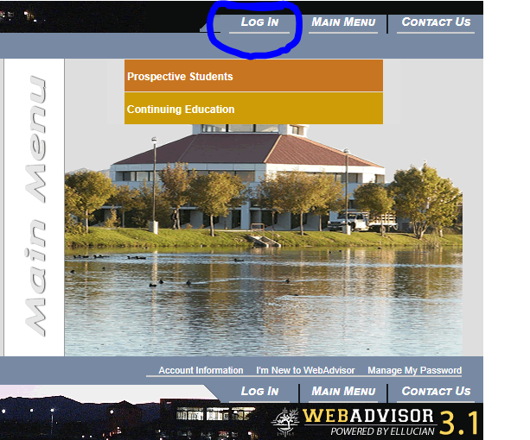
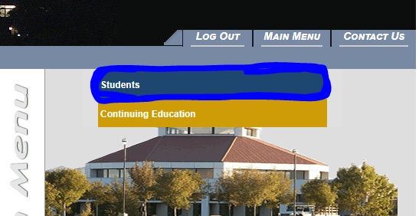
How do I setup my Webadvisor cont.
Step 2: Click login
Step 1: Click Webadvisor
Step 3:
Click students

Slide 11
How do I access my student email?
The student email is through Gmail. You will put your student email that was given to you where it asks for username or email, then click “next”. You will then put your birthday password in the following format Mmddyyyy (i.e. Jun011995)in the password box and click “sign in”
Your student email is in the following format (Webadvisorusername@student.vvc.edu)
If you have a personal Gmail account please make that you log out of your personal one
*Your student email is the primary form of communication from the school, ALL VVC communication from either staff or faculty will be sent to your student email. Check it often!*
If you need help signing into your student email please contact the helpdesk at
760-245-4271 ext. 2740

Slide 12
How do I apply for financial aid?
To apply for financial aid you need to go to https://fafsa.ed.gov/spa/fafsa/#/LOGIN?locale=en_US
Once you complete your FAFSA it takes between
10-14 business days for our financial aid office to receive it and process your application and apply it to your account.

Slide 13
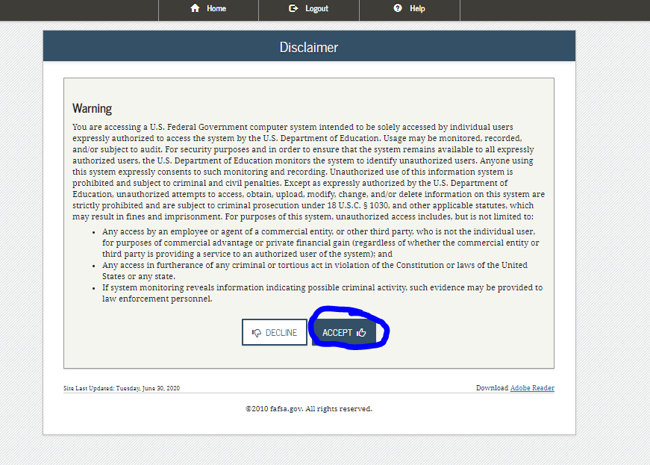
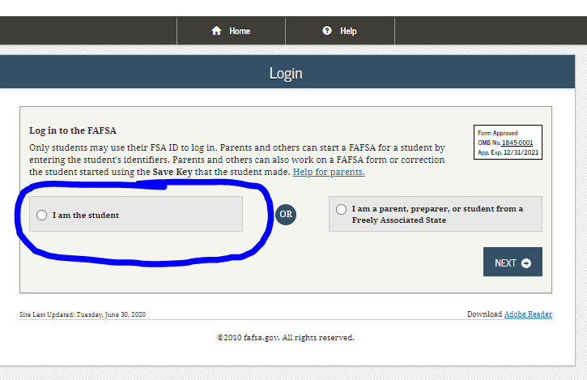
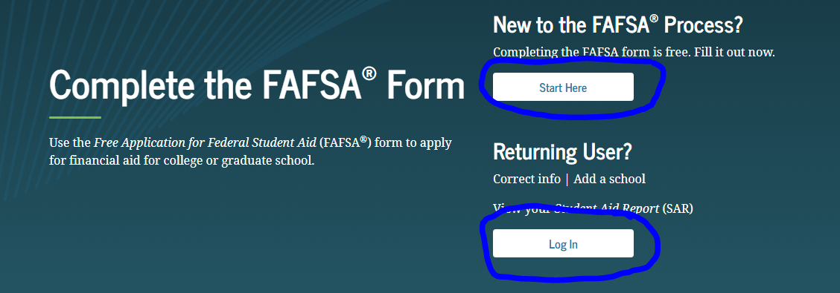
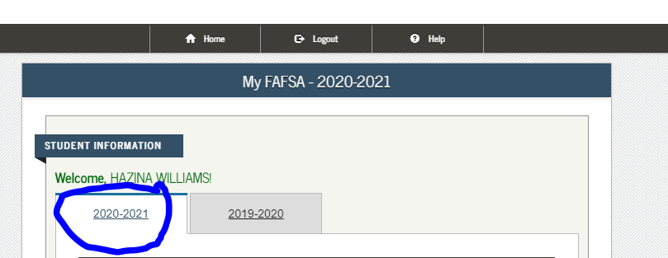
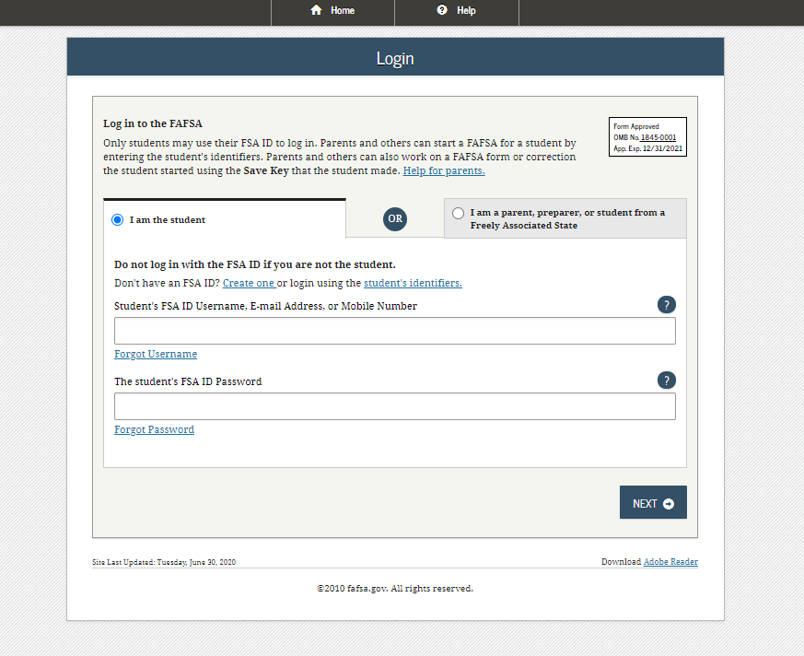
How do I apply for financial aid cont.
Step 3: Click
I am the student
Step 1:
Go to this website
Step 5:
Click accept
Step 2:
Click Start Here or Log In; both pages lead to the same page
Step 6: Start 2020-2021 FAFSA
Step 4:
Sign in with your FAFSA login information

Slide 14
Common FAFSA questions
If you are having problems logging into your FAFSA you can use the recover your username/password feature: you will need access to your email or phone or you can answer your challenge questions If that does not work you can contact the FAFSA department at 1-800-433-3243.
*If you use your challenge questions to reset your password you will NOT be able to log in for 30 minutes.*
If you are under 24 you will need your parents 2018 tax return (if applicable) and their personal information, if over 24/married/have children you will use you 2018 tax return (if applicable)
Should you have any questions regarding this process you can call 760-245-4271 ext. 2277 or 2453

Slide 15
How can I check what financial aid I am receiving?
You can log into your Webadvisor account and click “financial aid self service” to see if they have processed your FAFSA.
If everything is green that means the financial aid office has all they need. If there is anything that is yellow that means there are forms needed and you will want to click on the link to access what forms are required.
Once you turn in all required forms it can take up to 45 business days for them to get processed and your account updated.
There will be a link that says Award Letter, that is where you can check to see what awards have been issued.
If you have any questions please contact the financial aid office at
760-245-4271 ext. 2277

Slide 16
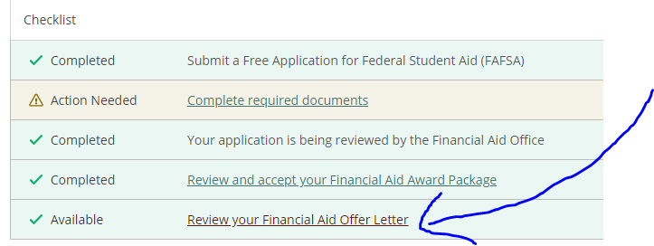
How can I check what financial aid I am receiving cont.
Step 1: Click on Financial Aid Self-Service
Step 3: If all is green, click Review your Financial Aid Offer Letter to check your awards
Step 2: Click the link in yellow to complete required documents (if applicable)

Slide 17
What is the Pell Grant and the CCPG?
Pell grant is FREE money that you can use for whatever needs that you might have.
CCPG is the grant that covers your tuition, so all you will need to pay are your student fees. If you have any questions regarding your fees please contact the Bursars office at 760-245-4271 ext. 2370 or by visiting their website at http://www.vvc.edu/offices/fiscal_services/bursars-office.shtml
You WILL NOT have to apply separately for any grants. Once you complete your FAFSA you will be awarded what you qualify for.
The amount that you will receive will depend on how many units you are enrolled in/household size/income.

Slide 18
How do I complete my placement survey and online orientation?
The placement survey (formally known as the assessment test) and the online orientation can both be accessed through Webadvisor.
The placement survey will take about 15 minutes and the online orientation will take approximately 1.5 hours
You will need to complete both of these things before you are able to speak with a counselor.
If you need assistance you can contact
760-245-4271 ext. 2752 or 2453 or 2826

Slide 19
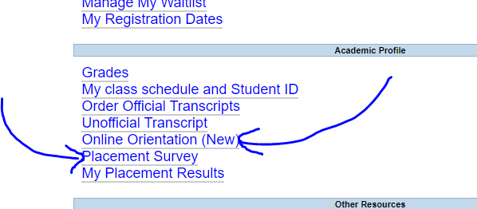
How do I complete my placement survey and online orientation cont.
Step 1: Click login
Step 2: Click students
Step 3: Click on the links to complete them

Slide 20
How do I setup an appointment to see a counselor?
In order to see a counselor to get an educational plan you will need to complete your online orientation and placement survey.
Since the campus is closed all appointments are through zoom or over the phone.
To make an appointment you can call the counseling department at 760-245-4271 ext. 2296 or 2531

Slide 21
How do I register for classes?
To register for classes you are going to log into your Webadvisor page. Click “register for sections” then click “click here”.
You will be redirected to the registration screen once there you will change the semester to the semester you are registering for and change section name to section subject and search for the classes listed in your educational plan.
Should you need help during this process you can contact
760-245-4271 ext. 2740 or 2453.

Slide 22
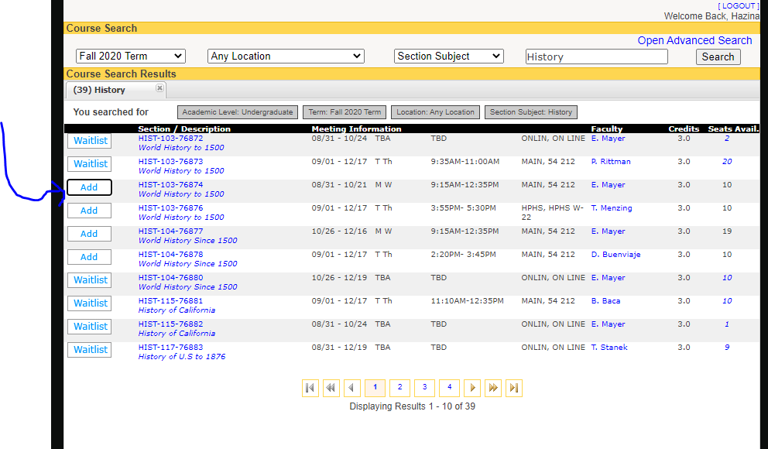
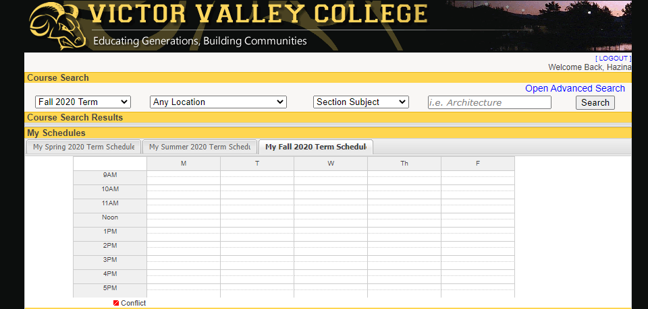
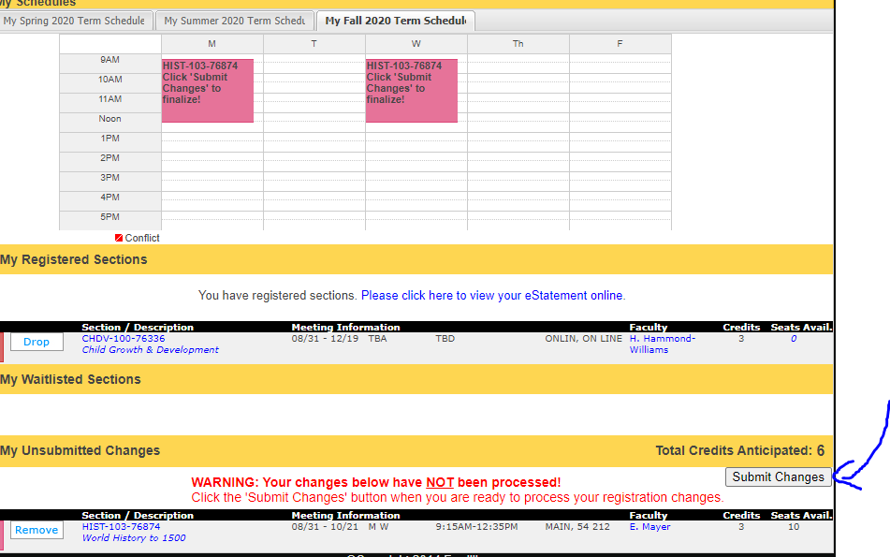
How do I register for classes cont.
Step 4: Type the subject in the search bar and click search then click the Add button
Step 1: Click on
register for sections
Step 3: Make sure your screen looks like this
Step 2: Click on
click here
Step 5: Make sure the class is under unsubmitted changes then click submit changes

Slide 23
What and how do I access Canvas?
Canvas is the portal that the campus uses for online cases.
To access canvas go to www.vvc.edu and click on the Canvas link at the top. The login information is the same as Webadvisor.
There is also online tutoring services through Canvas and the school should you need any assistance with your classes.
Should you need assistance with accessing canvas or have questions about online classes please contact
760-245-4271 ext. 2740 or 2453

Slide 24
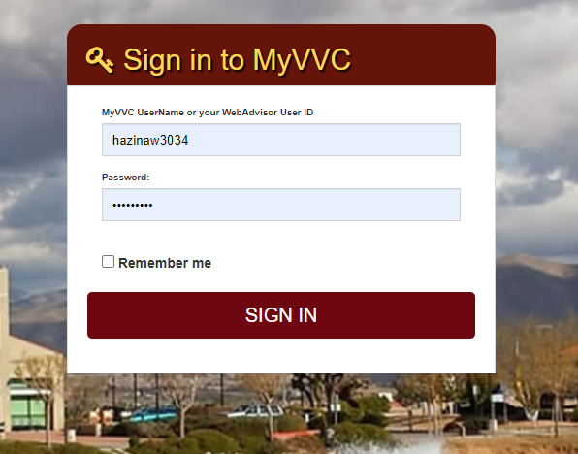
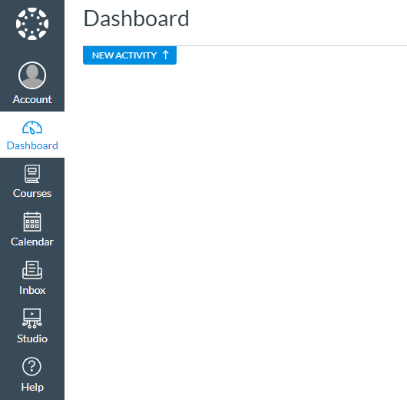
What and how do I access Canvas cont.
Step 3: Log in with your credentials
Step 1: Click on Canvas from the main school webpage
Step 4: Click on courses once the semester starts and you should see your classes
Step 2: Click on either link

Slide 25
How do I get my student ID?
If you need a student ID for the bus or for a special program that you are enrolled in you can call and make an appointment at
760-245-4271 ext. 2278 or 2395
You will need to have your registration statement with you that shows that you have a zero balance and a form of ID (i.e. drivers license)
*If you are enrolled in a payment plan you will need to contact the Bursars office at bursars.office@vvc.edu to get a special registration statement that shows you have a payment plan at*

Slide 26
Helpful numbers
Victor Valley College 760-245-4271
ACCESS ext. 2212
Admissions ext. 2272
ASB ext. 2278
Bookstore ext. 2259
Bursar ext. 2370
Counseling ext. 2296 or 2531
EOPS ext. 2422
Financial aid ext. 2277
Help desk ext. 2740
Placement Survey (Formally known as Assessment) ext. 2752
Student Services Lab ext. 2453
Transfer/Career Center ext. 2439

Slide 27
Helpful Websites
http://www.vvc.edu/
http://www.vvc.edu/offices/fiscal_services/bursars-office.shtml
https://www.opencccapply.net/gateway/apply?cccMisCode=991
http://www.vvc.edu/offices/admissions-records/
http://www.vvc.edu/offices/disabled_student_program_services/
http://www.vvc.edu/offices/financial-aid/
http://www.vvc.edu/offices/eops_and_care/
http://www.vvc.edu/offices/guidance_and_counseling/
http://vvcforme.com/pubinfomktg/2020/08/05/fall-2020-updates-remote-resources/
https://library.vvc.edu/welcome
http://www.vvc.edu/offices/career-center/
http://www.vvc.edu/tutoring-services/

