Slide 1


Faculty PD Events
Comprehensive Guide
2021 – 2022 AY
Victor Valley
College
Victor Valley College Proprietary & Confidential – for Internal Use Only

Slide 2


Slide 3
THEME:
Caring for our Instructors,
Who Care for our Students
Notes:
This Photo by Unknown Author is licensed under CC BY-SA

Slide 4

2021-22 AY Workshop Dates
Fall 2021
September 10, 2021
October 8, 2021
October 27, 2021
November 5, 2021
November 19, 2021
Spring 2022
February 25, 2022
March 11, 2021
April 29, 2022
May 13, 2022
May 20, 2022
Notes:
This Photo by Unknown Author is licensed under CC BY-SA

Slide 5

Instructors Supporting Instructors
We welcome your participation
and your presentations!
Notes:
This Photo by Unknown Author is licensed under CC BY-NC

Slide 6
Topics & Speakers

Slide 7
Professional Development Topics – Page 1
# | TOPIC | SPEAKER | DATE | REPLAY LINK
1 | Library Update | Leslie Huiner | 9/10/2021 | https://youtu.be/-2YnCIqJKZA
2 | Transfer Center Updates | Lorena Ochoa | 9/10/2021 | https://youtu.be/OVz1EjPisuA
3 | Canvas Video | Joe Pendleton | 10/8/2021 | https://youtu.be/5wufcRNPc68
4 | OEI Presentation (Online Education Initiative) | Gene Tashima | 10/8/2021 | https://youtu.be/2Jj0p587bGM
5 | Instructor Self Care | Tracy Davis | 10/8/2021 | https://youtu.be/t45bwlBdAxw
6 | Discussion Forums in Canvas | Regina Pierce-Brown | 10/22/2021 | https://youtu.be/dlZO7MypLwM
7 | Web Enhanced Classes | Michael Butros | 10/22/2021 | https://youtu.be/-ZfscpkDacc
8 | Canvas Course Design Tips | Brian DiBartolo | 10/22/2021 | https://youtu.be/kAk7jeDh8rs
9 | Student-Centered Approach to Teaching | Adam Moore | 11/5/2021 | https://youtu.be/o3HumIX47pc
10 | Un-Grading: Standards Based Grading | Michael Butros | 11/5/2021 | https://youtu.be/DbjDnUKfHpA

Slide 8
Professional Development Topics – Page 2
# | TOPIC | SPEAKER | DATE | REPLAY LINK
11 | Flipped Classroom for Active Student Learning | Regina Pierce-Brown | 11/5/2021 | https://youtu.be/iEFQDxeEtZ0
12 | Student Engagement | Brian Quarles | 11/19/2021 | https://youtu.be/YdOIk4MFed0
13 | CTE Programs Post-COVID | Troy Kuhns | 11/19/2021 | https://youtu.be/y9w4mNxYET0
14 | VVC Student Scholarships | Chris Nunez | 11/19/2021 | https://youtu.be/fjEsHoc18WY
15 | Asset-Based Approach | Dr. Brett Christie | 2/25/2022 | https://youtu.be/V6wMST4pfGY
16 | Faculty Fuel tools (VVC Records Demo) - Self-Service Demo from Records Office | Dr. Todd Scott & Ken Wolpin | 2/25/2022 | https://youtu.be/1y7xcMikKlw
17 | Make Humanized Your Modality | Dr. Brett Christie | 2/25/2022 | https://youtu.be/tqxEMZfUWSk
18 | Basic Video Editing Tips | Joe Pendleton | 3/11/2022 | https://youtu.be/x8R5wT_UjhE
19 | Online and On-Campus Classroom Management | Tracy Davis | 3/11/2022 | https://youtu.be/isV1ndxnewM
20 | Canvas Best Practices | Lisa Kennedy | 3/11/2022 | https://youtu.be/41Ql_k6uPd8

Slide 9
Professional Development Topics – Page 3
# | TOPIC | SPEAKER | DATE | REPLAY LINK
21 | Curbing Classroom Cheating – Part 1 | Regina Pierce-Brown | 4/29/2022 | https://youtu.be/-tEQ4Kw9FpE
22 | Embedding DEI in the Budget Augmentation Process | Dr. Henry Young | 4/29/2022 | https://youtu.be/3fLGLNquAcA
23 | SLOAC Presentation | SLOAC Committee | 4/29/2022 | https://youtu.be/LwnyIAz0TcI
24 | Liquid Syllabus (Humanizing Your Course, Part 1) | Dr. Jamey Cooper | 5/13/2022 | https://youtu.be/txGaee3HNOE
25 | Open Educational Resource (OER) | Yvonne Reed | 5/13/2022 | https://youtu.be/DxTMVoGs-DY
26 | SLO/PLO Assessment | Julia Wendt | 5/13/2022 | https://youtu.be/nEi4RuXHwJY
27 | Converting Classic Quizzes in Canvas | Brian DiBartolo | 5/13/2022 | https://youtu.be/UcJFFTP-CRk
28 | e-Portfolios (Humanizing Your Course, Part 2) | Dr. Jamey Cooper | 5/20/2022 | https://youtu.be/ISf_vTshQo0
29 | Bridge 3.0 The RESET - Reaching Out to Minority & Low-Income Students | Michael Edwards | 5/20/2022 | https://youtu.be/7Pqe4ojndto
30 | Curbing Classroom Cheating – Part 2 | Regina Pierce-Brown | 5/20/2022 | https://youtu.be/lOPxtN9Q7vc

Slide 10
Instructors Supporting Instructors
Visit our Canvas site: https://vvc.instructure.com/courses/1476
Need access? Email regina.brown@vvc.edu
Notes:
This Photo by Unknown Author is licensed under CC BY-NC

Slide 11
1.
VVC Library Resources for Faculty:
Leslie Huiner https://youtu.be/-2YnCIqJKZA

Slide 12
VVC Library Resources for Faculty by Leslie Huiner
Leslie will share VVC Library resources to support your curriculum and student learning, including the library website, catalog and databases.
https://library.vvc.edu/welcome
https://library.vvc.edu/support/faculty

Slide 13
2.
Lorena Ochoa:
Transfer Center Updates https://youtu.be/OVz1EjPisuA

Slide 14
Transfer Center Updates by
Lorena Ochoa
Lorena Ochoa has worked at VVC since August 2007 as a Bilingual Counselor. Her primary role was working with ESL students and the general student population. In April 2011, she took over the role of Transfer Counselor as she continued to work with ESL students. As a Transfer Counselors, Lorena's work involved counseling transfer-bound students, coordinating events, workshops, writing reports, building collaborations with universities, and hosting the annual University Transfer Fair and end-of-year Transfer Celebration! In September 2022, Lorena began to assist in the Health Sciences Pathway. She is looking forward to continuing to help our Health Sciences pathways students who plan to receive degrees at VVC or transfer to other institutions and continue to help the ESL population! It has been a rewarding experience working at VVC and she looks forward to the many opportunities the future holds!

Slide 15
3.
Canvas Videos by
Joe Pendleton https://youtu.be/5wufcRNPc68

Slide 16

Canvas Videos by
Joe Pendleton

Slide 17
4.
OEI Presentation (Online Education Initiative):
Gene Tashima https://youtu.be/2Jj0p587bGM

Slide 18
OEI Presentation (Online Education Initiative) by Gene Tashima
Today's classrooms have changed drastically from the pre-COVID traditional face-to-face instruction with which we have been familiar. Come join our VVC instructor Gene Tashima as he shares experienced thoughts and new techniques for student success. He will cover:
Implementing OEI (online educational initiative) rubrics / course development
Using Canvas features to manage your face-to-face classes
Striving for high student engagement, connection, and interaction
Viewing learning assignments as opportunities for repetition and success
Gene recently implemented these methods to improve the course completion rate in his SOC courses with one Spring class reporting at 100% completion rate! Come and find out how you can incorporate his tips, tricks, and techniques into your classes and raise your student success rate.

Slide 19
5.
Instructor Self-Care: Tracy Davis https://youtu.be/t45bwlBdAxw

Slide 20
Instructor Self-Care by Tracy Davis
Instructor Self-Care Books from Amazon
180 Days of Self-Care for Busy Educators (A 36-Week Plan of Low-Cost Self-Care for Teachers and Educators) by Tina H. Boogren
https://www.amazon.com/Self-Care-Educators-36-Week-Low-Cost-Teachers/dp/194953927X
SOUL!: Fulfilling the Promise of Your Professional Life as a Teacher and Leader (A professional wellness and self-reflection resource for educators at every grade level) by Timothy D. Kanold
https://www.amazon.com/gp/product/195107565X
Take Time for You: Self-Care Action Plans for Educators (Using Maslow's Hierarchy of Needs and Positive Psychology) by Tina H. Boogren
https://www.amazon.com/Take-Time-You-Self-Care-Psychology/dp/1945349719
Onward: Cultivating Emotional Resilience in Educators by Elena Aguilar
https://www.amazon.com/Onward-Cultivating-Emotional-Resilience-Educators/dp/1119364892
The Onward Workbook: Daily Activities to Cultivate Your Emotional Resilience and Thrive by Elena Aguilar
https://www.amazon.com/Onward-Workbook-Activities-Cultivate-Resilience/dp/1119367387
HEART!: Fully Forming Your Professional Life as a Teacher and Leader (Support Your Passion for the Teaching Profession and Become a More Effective Educator) by Timothy D. Kanold
https://www.amazon.com/HEART-Professional-Teaching-Profession-Effective-dp-1943874433/dp/1943874433

Slide 21
6.
Discussion Forums in Canvas
Regina Pierce-Brown https://youtu.be/dlZO7MypLwM

Slide 22
Discussion Forums in Canvas
Regina Pierce-Brown (Part 1)
Handout for Notes: Discussion Forums - Handout.docx <INSERT>
Supplemental Resources - Books Recommended in Regina's Presentation on Discussion Forums
Relationship-Rich Education: How Human Connections Drive Success in College by Peter Felten and Leo M. Lambert
https://www.amazon.com/Relationship-Rich-Education-Connections-Success-College/dp/1421439360
Teaching College: The Ultimate Guide to Lecturing, Presenting, and Engaging Students by Dr. Norman Eng
https://www.amazon.com/dp/0998587516
Fifty Strategies to Boost Cognitive Engagement: Creating a Thinking Culture in the Classroom (50 Teaching Strategies to Support Cognitive Development)
https://www.amazon.com/Fifty-Strategies-Boost-Cognitive-Engagement/dp/1947604775

Slide 23
Discussion Forums in Canvas
Regina Pierce-Brown (Part 2)
Discussion Forums - Other Recommended Books for Faculty
Creating Engaging Discussions: Strategies for "Avoiding Crickets" in Any Size Classroom and Online by Jennifer H. Herman and Linda B. Nilson
https://www.amazon.com/Creating-Engaging-Discussions-Strategies-Classroom/dp/162036560X
The Teacher′s Guide to Leading Student-Centered Discussions: Talking About Texts in the Classroom by Michael S. Hale, Elizabeth A. City
https://www.amazon.com/Teacher%E2%80%B2s-Guide-Leading-Student-Centered-Discussions/dp/1412906350
Teaching & Learning through Discussion: A Trouble-Shooting Guide by Richard G. Tiberius
https://www.amazon.com/Teaching-Learning-through-Discussion-Trouble-Shooting/dp/1581071612

Slide 24
Discussion Forums in Canvas
Regina Pierce-Brown (Part 3)
Discussion Forums - Additional resources (3CSN webinar session 10/21/2021):
https://drive.google.com/file/d/1w1X5GfTTBAKzyn0RV0s4PBW8XLcydnXY/view?usp=sharing
https://drive.google.com/file/d/1vl-StTlWB7_UztnoD0QgjWEMU5lXB_wo/view
https://docs.google.com/presentation/d/13bDKiFHUWcanX2zD_lwkU17cDY1aYgGVyJGcH7PTBcs/edit#slide=id.gbd0c5c1bb3_0_225
https://insidehighered.podbean.com/e/ep-52-preparing-for-a-fall-of-caring-for-students

Slide 25
7.
Web Enhanced Classes:
Michael Butros https://youtu.be/-ZfscpkDacc

Slide 26
Web Enhanced Classes:
Michael Butros
Here are the pdf slides from Michael's presentation on web-enhanced classes. <INSERT> Web-Enhanced Classes slide deck Michael Butros.pdf
From Michael Butros, below is the link for the code faculty can use to get tabs within any of their canvas pages: https://atguides.humboldt.edu/m/canvas_instructor_guides/l/768704-how-do-i-create-tabs-in-my-canvas-page

Slide 27
8.
Canvas Course
Design Tips:
Brian DiBartolo https://youtu.be/kAk7jeDh8rs

Slide 28
Canvas Course Design Tips:
Brian DiBartolo
Course Design - Books Recommended
Reach Everyone, Teach Everyone: Universal Design for Learning in Higher Education (Teaching and Learning in Higher Education) by Thomas J. Tobin and Kirsten T. Behling
https://www.amazon.com/Reach-Everyone-Teach-Universal-Education/dp/1946684600
The Learner-Centered Instructional Designer: Purposes, Processes, and Practicalities of Creating Online Courses in Higher Education by Jerod Quinn
https://www.amazon.com/Learner-Centered-Instructional-Designer-Processes-Practicalities/dp/1642670413

Slide 29
9.
Student-Centered Approach to Teaching:
Adam Moore https://youtu.be/o3HumIX47pc

Slide 30

Student-Centered Approach to Teaching: Adam Moore
For information about welcoming students to class with RAM coaching, please email Dean Jackie Augustine.

Slide 31
10.
Un-Grading: Standards Based Grading:
Michael Butros https://youtu.be/DbjDnUKfHpA

Slide 32
Un-Grading: Standards Based Grading: Michael Butros (PART 1)
Website: https://www.masterygrading.com/resources
Slide deck to download: Ungrading - Standards Based Grading presentation by Michael Butros.pdf
<INSERT>

Slide 33
Un-Grading: Standards Based Grading: Michael Butros (PART 2)
Standards-Based Grading Book Recommendations
Specifications Grading: Restoring Rigor, Motivating Students, and Saving Faculty Time by Linda B. Nilson
https://www.amazon.com/Specifications-Grading-Restoring-Motivating-Students/dp/1620362422
Ungrading: Why Rating Students Undermines Learning (and What to Do Instead) (Teaching and Learning in Higher Education) by Alfie Kohn
https://www.amazon.com/Ungrading-Students-Undermines-Learning-Education/dp/1949199827
Grading for Equity: What It Is, Why It Matters, and How It Can Transform Schools and Classrooms by Joe Feldman
https://www.amazon.com/Grading-Equity-Matters-Transform-Classrooms/dp/1506391575
Planning and Teaching in the Standards-Based Classroom by Jeff Flygare, Jan K. Hoegh, and Tammy Heflebower
https://www.amazon.com/dp/1943360715

Slide 34
Un-Grading: Standards Based Grading: Michael Butros (PART 3)
A Teacher's Guide to Standards-Based Learning (An Instruction Manual for Adopting Standards-Based Grading, Curriculum, and Feedback) Teachers Guide Edition by Tammy Heflebower, Jan K. Hoegh, Philip B. Warrick, Jeff Flygare, and Robert J. Marzano
https://www.amazon.com/Teachers-Standards-Based-Learning-Instruction-Curriculum/dp/1943360251
The Standards-Based Classroom: Make Learning the Goal by Emily A. Rinkema and Stan Williams
https://www.amazon.com/Standards-Based-Classroom-Make-Learning-Goal/dp/1544324200
Un-Standardizing Curriculum: Multicultural Teaching in the Standards-Based Classroom by Christine E. Sleeter and Judith Flores Carmona
https://www.amazon.com/Standardizing-Curriculum-Multicultural-Standards-Based-Classroom/dp/0807758078
Standards-Based Learning in Action: Moving from Theory to Practice (A Guide to Implementing Standards-Based Grading, Instruction, and Learning) by Tom Schimmer, Garnet Hillman, and Mandy Stalets
https://www.amazon.com/Standards-Based-Learning-Action-Implementing-Instruction/dp/1945349018

Slide 35
11.
Flipped Classroom for Active Student Learning:
Regina Pierce-Brown https://youtu.be/iEFQDxeEtZ0

Slide 36
Flipped Classroom for Active Student Learning: Regina Pierce-Brown (1)
Flipped Classroom Book Recommendations:
Flipping the College Classroom: Practical Advice from Faculty by Barbi Honeycutt
https://www.amazon.com/Flipping-College-Classroom-Practical-Faculty/dp/0912150289
Flipped Learning: A Guide for Higher Education Faculty by Robert Talbert
https://www.amazon.com/Flipped-Learning-Higher-Education-Faculty/dp/1620364328
Flipped Classrooms with Diverse Learners: International Perspectives by Zachary Walker
https://www.amazon.com/Flipped-Classrooms-Diverse-Learners-International/dp/9811541701

Slide 37
Flipped Classroom for Active Student Learning: Regina Pierce-Brown (2)
The Differentiated Flipped Classroom: A Practical Guide to Digital Learning by Eric M. Carbaugh and Kristina J. Doubet
https://www.amazon.com/Differentiated-Flipped-Classroom-Practical-Essentials/dp/1506302963
Flipping the College Classroom: An Evidence-Based Guide by Patricia V. Roehling
https://www.amazon.com/Flipping-College-Classroom-Evidence-Based-Guide-dp-331988770X/dp/331988770X
Best Practices for Flipping the College Classroom (Best Practices in Online Teaching and Learning) by Julee B. Waldrop and Melody A. Bowdon
https://www.amazon.com/Practices-Flipping-Classroom-Teaching-Learning/dp/1138021733

Slide 38
12.
Class Engagement & Interaction:
Brian Quarles https://youtu.be/YdOIk4MFed0

Slide 39
Class Engagement & Interaction:
Brian Quarles (part 1)
Tools for Engagement, Interactivity, & Collaboration as recommended by Brian Quarles in his presentation.
Online Apps
Poll Everywhere app - https://www.polleverywhere.com
Socrative - https://www.socrative.com
Kahoot! - https://kahoot.it
Padlet - https://padlet.com
Non-Web Approaches
Socratic
Think - Pair - Share
Critical thinking exercises / discussions
Scaffolding
Humor

Slide 40
Class Engagement & Interaction:
Brian Quarles (part 2)
Class Engagement & Interaction (Books Recommended)
As a follow-up to Brian Quarles' presentation, you may enjoy reading one of these books.
Five Paths of Student Engagement: Blazing the Trail to Learning and Success (Your Guide to Promoting Active Engagement in the Classroom and Improving Student Learning) by Dennis Shirley and Andy Hargreaves
https://www.amazon.com/gp/product/1942496680
Peer Feedback in the Classroom: Empowering Students to Be the Experts by Starr Sackstein
https://www.amazon.com/Peer-Feedback-Classroom-Empowering-Students/dp/1416623663
Teaching College: The Ultimate Guide to Lecturing, Presenting, and Engaging Students by Dr. Norman Eng
https://www.amazon.com/dp/0998587516

Slide 41
Class Engagement & Interaction:
Brian Quarles (part 3)
Student Engagement Techniques: A Handbook for College Faculty by Elizabeth F. Barkley and Claire H. Major
https://www.amazon.com/Student-Engagement-Techniques-Handbook-College/dp/1119686776
Fifty Strategies to Boost Cognitive Engagement: Creating a Thinking Culture in the Classroom (50 Teaching Strategies to Support Cognitive Development)
https://www.amazon.com/Fifty-Strategies-Boost-Cognitive-Engagement/dp/1947604775
Distracted: Why Students Can't Focus and What You Can Do About It by James M. Lang
https://www.amazon.com/Distracted-Students-Cant-Focus-About/dp/1541699807

Slide 42
13.
CTE Programs
Post-COVID:
Troy Kuhns https://youtu.be/y9w4mNxYET0

Slide 43
CTE Programs Post-COVID:
Troy Kuhns
https://www.vvc.edu/career-education
“Career Education (CE) is a driver for workforce development and economic prosperity in the Victor Valley. Victor Valley College offers over 100 career education and workforce training programs preparing individuals for skilled jobs in an ever-changing labor market.
“CE courses offer students the ability to learn skills needed to land opportunities in a high-wage, high-demand field of their choosing. Career Education courses deliver a technical, core academic education and the employable knowledge individuals need for prolonged career success. CE students can develop problem-solving capabilities, project-completion skills, research competence, communication tools, time management proficiency, and critical thinking skills through their college coursework. Coursework is comprehensive and rigorous, allowing for career exploration and skill development inside and outside the classroom. Courses provide individuals with options for whatever their future endeavors entail.”

Slide 44
14.
VVC Scholarships:
Chris Nunez https://youtu.be/fjEsHoc18WY

Slide 45
VVC Scholarships: Chris Nunez
VVC Foundation - Scholarship Links
https://vvcfoundation.com/scholarships
https://vvcfoundation.com/vvcf-scholarships
https://www.vvc.edu/scholarship-opportunities
VVC Foundation - Student Funds for Bookstore
"Links and funds are still being organized, so I will be following up with some of the other resources I discussed. In the meantime, this is the link for this Fall term. If a student has not received it already, they can be input and start using the funds to purchase books for Winter/Spring. The next link and round of funding will be made available later this month and we will share that as well as soon as it is ready.” ~ Message from Christopher Nunez
Student Assistance Referral Form (google.com): https://docs.google.com/forms/d/e/1FAIpQLSfoQGB_dD2t596ZoJEJIED_ICSb9S6wzSIvZ0cqNk9T9ZwP5A/viewform

Slide 46
15.
Asset-Based Approach:
Dr. Brett Christie https://youtu.be/V6wMST4pfGY

Slide 47
Asset-Based Approach
Dr. Brett Christie
Asset-Based Slide Deck:
<INSERT>
What’s on your mind these days?
Answer garden: https://answergarden.ch/2362696
Your Asset-Based Status (responses):
https://padlet.com/brettodlearn/vvc_asset1
Moving Further with Asset-Based (responses):
https://padlet.com/brettodlearn/vvc_asset2
Group project participation tool submitted by Dean Trish Ellerson:
<INSERT>

Slide 48
16.
Faculty Fuel Tools (VVC Records Demo) - Self-Service Demo: Dr. Todd Scott & Ken Wolpin (Records Office) https://youtu.be/1y7xcMikKlw

Slide 49
Self-Service Demo: Records Office
VVC Admissions and Records - Faculty Resources
www.vvc.edu/admissions-and-records-faculty-resources
Forms
Census and Drop Roster Steps
Positive Attendance Procedures
Grading Steps
Authorization Codes Steps

Slide 50
17.
Make Humanized Your Modality
Dr. Brett Christie https://youtu.be/tqxEMZfUWSk

Slide 51
Make Humanized Your Modality
Dr. Brett Christie (Page 1)
Resources Mentioned
Guest speaker: Brett Christie, Ph.D.
Slide Deck link: Humanizing <INSERT>
Purposeful Learning: It's Where You Start and End
From O'Donnell Learn Video: https://youtu.be/HoL0QJ8tQQs
Empathy Map
For a copy of the full Empathy Map resource with context, instructions, and empathy map (completed and blank) go to
https://www.odlearn.com/empathy-mapping
The Purposeful Learning Framework
https://www.odlearn.com/purposeful-learning
Welcome to the Purposeful Learning Check
https://vimeo.com/533628885?embedded=true&source=vimeo_logo&owner=120929032

Slide 52
Make Humanized Your Modality
Dr. Brett Christie (Page 2)
Your current efforts to humanize your courses?
View full responses: https://padlet.com/brettodlearn/vvc_humanize1
Course Welcome in Flipgrid
“The simplest way to see and hear from your students, anytime and anywhere! 100% FREE from Microsoft.”
Any instructor can sign up at www.flipgrid.com
Flipgrid how-to: https://drive.google.com/file/d/1SMSFzZ8XwC2cdrJfxa4k_ud8a1MvWVOS/view
Critical Elements of The Course Syllabus
Taylor, S.D., Veri, M.J., Eliason, M., Hermoso, J.C.R., Bolter, N.D., & Van Olphen, J.E. (2019). The social justice syllabus design tool: A first step in doing social justice pedagogy. Journal Committed to Social Change on Race and Ethnicity, 5(2).
https://journals.shareok.org/jcscore/article/view/87/58
Welcoming vs. Unwelcoming Syllabus
Access full resource at: https://www.odlearn.com/un-welcome-syllabus

Slide 53
Make Humanized Your Modality
Dr. Brett Christie (Page 3)
Reflecting on Your Syllabus
https://www.odlearn.com/enhanced-syllabus-checklist
Humanizing Your Syllabus
Many examples at:
https://enact.sonoma.edu/c.php?g=789377&p=5650618
Some Ideas for Connecting Early & Often
Learner Connectedness Survey. Editable copy at: http://tiny.cc/odl-inclusivity-survey
Stay Present as Their Instructor
Tips on creating “humanized” videos to communicate with your students: https://youtu.be/s0lQJvBC_1I
Multiple Means = Multiple Pathways
https://www.odlearn.com/techniques-for-remote-active-learning

Slide 54
Make Humanized Your Modality
Dr. Brett Christie (Page 4)
Discussion: Connecting with a Purpose
What will be your next efforts to create more humanized course experiences?
View full responses: https://padlet.com/brettodlearn/vvc_humanize2
Liquid Syllabus
“An accessible, public website that incorporates a brief, friendly welcome video and course information written in welcoming, student-centered language” https://ccconlineed.instructure.com/courses/6771
Liquid syllabus example from our very own Dr. Jamey Cooper: https://sites.google.com/view/earthsciencesbyjameycooper/home
Humanizing Learning in Higher Ed
Michelle Pacansky-Brock - Humanizing online learning in higher education with emerging technologies – YouTube channel: https://www.youtube.com/user/mpacanskybrock
Pedagogy of Kindness
Catherine Denial
@catedenial
https://hybridpedagogy.org/pedagogy-of-kindness
Useful Tools
Flyer creation tool: www.canva.com
Random item generator: www.Perchance.org/object
Mind mapping online: www.bubbl.us

Slide 55
18.
Basic Video Editing Tips:
Joe Pendleton https://youtu.be/x8R5wT_UjhE

Slide 56
Video Editing by
Joe Pendleton
Basic Video Editing will cover core issues with editing, such as adding cards for organization of content. Includes the basic issues in production and editing of instructional video so your lecture on Business Law or Tectonic Plates or even Quantum Mechanics are as engaging as the latest viral dance video on Tic-Tok. Or almost. The Workshop teaches you to cut basic mistakes, such as “ums” or sneezes or barking dog or screaming kids, but also to create basic titles and slides that organize the content of your material on the video itself, so your students see in writing what you present in spoken words.

Slide 57
19.
Classroom Management
On-Campus and Online:
Tracy Davis https://youtu.be/isV1ndxnewM

Slide 58
Classroom Management On-Campus and Online by Tracy Davis
View slide deck here: Classroom Management - slide deck - Tracy Davis.pdf <INSERT>
RESOURCES:
VVC Standards of Conduct
From https://canvas.vvc.edu Links to an external site.: Students further affirm that they have read, understand, and agree to follow the requirements of VVC Board Policy 5500 Links to an external site.Standards of Conduct Links to an external site., VVC Links to an external site.Administrative Procedure 5520(a) Links to an external site.Student Discipline Procedures., and VVC Links to an external site.Administrative Procedure 3720(a) C Links to an external site.omputer and Electronic Communication Systems Links to an external site..
Developing a Learning Classroom: Moving Beyond Management Through Relationships, Relevance, and Rigor by Cooper & Garner
https://www.amazon.com/Developing-Learning-Classroom-Management-Relationships/dp/1452203881
The Multiplier Effect: Tapping the Genius Inside Our Schools by Liz Wiseman, Lois N. Allen, and Elise Foster
https://www.amazon.com/gp/product/1452271895
FILES AVAILABLE FOR DOWNLOAD:
Student Discipline Procedures AP 5520(a) without highlight.pdf
Inappropriate Student Behavior Report Form.pdf

Slide 59
20.
Canvas Best Practices:
Lisa Kennedy https://youtu.be/41Ql_k6uPd8

Slide 60
Canvas Updates & New Features by Lisa Kennedy

Slide 61
21.
Curbing Classroom Cheating (Part 1):
Regina Pierce-Brown https://youtu.be/-tEQ4Kw9FpE

Slide 62
Curbing Classroom Cheating
PART 1
Slides: Curbing Classroom Cheating SLIDES.pdf <INSERT>
Resources:
Davis, S.F., Drinan, P.F., and Gallant, T.B. 2009. Cheating in School: What We Know and What We Can Do.
https://www.amazon.com/Cheating-School-What-Know-Can-dp-1405178043/dp/1405178043
Eaton, S.E. 2021. Plagiarism in Higher Education: Tackling Tough Topics in Academic Integrity (2021)
https://www.amazon.com/Plagiarism-Higher-Education-Tackling-Integrity/dp/1440874379
Lang, J.M. 2013. Cheating Lessons: Learning from Academic Dishonesty.
https://www.amazon.com/Cheating-Lessons-Learning-Academic-Dishonesty/dp/0674724631
McCabe, D.L., Butterfield, K.D., & Trevino, L.K. 2017. Cheating in College: Why Students Do It and What Educators Can Do about It.
https://www.amazon.com/Cheating-College-Students-Educators-about/dp/1421424010
Rettinger, D., & Gallant, T.B. 2022. Cheating Academic Integrity: Lessons from 30 Years of Research.
https://www.amazon.com/Cheating-Academic-Integrity-Lessons-Research/dp/1119868173

Slide 63
22.
Embedding DEI in the Budget Augmentation Process: Dr. Henry Young https://youtu.be/3fLGLNquAcA

Slide 64
Embedding DEI in the Budget Augmentation Process: Dr. Henry Young (p. 1)
Slides: DEIA Professional Development Workshop Spring 2022 SLIDES.pdf <INSERT>
Email from Henry Young 11/15/2022: Hello Faculty, Staff and Administrators, I hope you are healthy mentally and physically and your semester is going well. I thought it appropriate to share an interesting article I read concerning increasing "Men of Color" success rates in community colleges. According to the KRESGE foundation authors of this study, "Longstanding concerns about the enrollment, retention and success of men of color (e.g., Black, Latino/Hispanic, Native American, Pacific Islander, and Southeast Asian) in community colleges have been exacerbated by the effects of the COVID-19 pandemic. While community college student enrollments declined by 13% during the pandemic, Black and Native American men declined by 26% and 24%, respectively. High attrition and low completion rates for men of color have also garnered community college leaders' and policymakers' attention and concern". To this point, all students' enrollments, retention, and success rates are important to Victor Valley College. However, in response to recent disturbing social and racial injustice trends, intentionally identifying ways to increase disproportionately impacted and minoritized "Men of Color" success is essential to meet Districts EMP Goal #1, centered on student experience and success. Moreover, ensuring equity-minded frameworks that foster attitudes toward cultural diversity, inclusivity, and cultural humility. Please take a few minutes to read this Seminole-authored study to increase awareness and opportunities for improvement related to this crucial cultural redesign to increase student success. https://kresge.org/resource/increasing-the-enrollment-retention-and-success-of-men-of-color-in-community-colleges

Slide 65
Embedding DEI in the Budget Augmentation Process: Dr. Henry Young (p. 1)
Equity, Diversity, & Inclusion Books & Resources
From Equity Talk to Equity Walk: Expanding Practitioner Knowledge for Racial Justice in Higher Education by Tia Brown McNair, Estela Mara Bensimon, and Lindsey Malcom-Piqueux
https://www.amazon.com/Making-Excellence-Inclusive-Framework-Advancing/dp/1119237912
Culturally Sustaining Pedagogies: Teaching and Learning for Justice in a Changing World (Language and Literacy Series) by Django Paris, H. Samy Alim, Celia Genishi, & Donna E. Alvermann
https://www.amazon.com/Culturally-Sustaining-Pedagogies-Teaching-Learning/dp/0807758337

Slide 66
Embedding DEI in the Budget Augmentation Process: Dr. Henry Young (p. 2)
Bandwidth Recovery: Helping Students Reclaim Cognitive Resources Lost to Poverty, Racism, and Social Marginalization by Cia Verschelden
https://www.amazon.com/Bandwidth-Recovery-Cognitive-Resources-Marginalization/dp/1620366053
Culturally Responsive Teaching and The Brain: Promoting Authentic Engagement and Rigor Among Culturally and Linguistically Diverse Students by Zaretta L. Hammond
https://www.amazon.com/Culturally-Responsive-Teaching-Brain-Linguistically/dp/1483308014
Reaching and Teaching Students in Poverty: Strategies for Erasing the Opportunity Gap (Multicultural Education Series) by Paul C. Gorski and James A. Banks
https://www.amazon.com/Reaching-Teaching-Students-Poverty-Multicultural/dp/0807758795

Slide 67
23.
SLOAC Presentation:
SLOAC Committee https://youtu.be/LwnyIAz0TcI

Slide 68
SLOAC Presentation
SLOAC Committee Chair, Patty Golder
SLOAC Committee Members: Daniel Vecchio, Nathan Franklin
<INSERT SLIDE DECK>
SLOAC handbook
<insert new link>
ILOs on the VVC website:
https://www.vvc.edu/learning-outcomes-slos-plos-and-ilos
ILOs in the catalog:
https://catalog.vvc.edu/about-vvc/learning-outcomes

Slide 69
24.
Liquid Syllabus
(Humanizing Your Course, Part 1): Dr. Jamey Cooper https://youtu.be/txGaee3HNOE

Slide 70
Liquid Syllabus (Humanizing Your Course, Part 1): Jamey Cooper
Presentation slide deck: https://docs.google.com/presentation/d/1jFgK5Dw9hv0iSwaQ5o-63HeI3I382ERgGWwzretp2_Q/view
PDF version: Liquid Syllabus - Jamey Cooper SLIDES.pdfDownload Liquid Syllabus - Jamey Cooper SLIDES.pdf <INSERT>
Examples of Liquid Syllabi:
• Jamey Cooper: https://sites.google.com/view/earthsciencesbyjameycooper/home
• Michelle Pacansky-Brock: https://sites.google.com/view/hosp-welcome/home
• Fabiola Torres: https://sites.google.com/view/ethnicstudiesbyfabiolatorres
• Brent Wedge: https://sites.google.com/view/csci270-welcome/home
• Sarah Williams: https://sites.google.com/view/math-1a-student-faq
If you are interested in creating a liquid syllabus, following is a self-paced Canvas module that demonstrates the steps from Michelle Pacansky-Brock:
https://ccconlineed.instructure.com/courses/6771
Jamey would be happy to meet with you if requested. Email: Jamey.cooper@vvc.edu

Slide 71
25.
Open Educational Resources (OER):
Yvonne Reed https://youtu.be/DxTMVoGs-DY

Slide 72
Open Educational Resources (OER): Yvonne Reed
VVC OER Resources:
https://library.vvc.edu/support/OER
Finding OER - Faculty Guide:
https://library.vvc.edu/c.php?g=1199673&p=8773900
Canvas Commons:
https://asccc-oeri.org/oeri-resources-in-canvas-commons
VVC Library Site:
https://library.vvc.edu/welcome

Slide 73
26.
SLOs and PLOs:
Dr. Julia Wendt https://youtu.be/nEi4RuXHwJY

Slide 74
Student Learning Outcomes (SLO) and Program Learning Outcomes (PLO): Julia Wendt
SLO Assessment Tutorials: https://www.vvc.edu/slo-assessment-tutorials
SLO Coordinator Office Hours
Materials - sample form & files
Training Videos and Resource links
Directions to submit your SLO Assessment forms
SLO, PLO, & ILO info: https://www.vvc.edu/learning-outcomes-slos-plos-and-ilos
Searchable Online Databases of Active SLO Reports by Term
PLOs by Program
Institutional Learning Outcomes (ILOs)
Notes:
TOTAL: 2 hours + 45 minutes
This Photo by Unknown Author is licensed under CC BY-SA

Slide 75
27.
Converting Classic Canvas Quiz "Test Banks" into New Quiz "Item Banks“:
Brian DiBartolo https://youtu.be/UcJFFTP-CRk
Notes:
Campus Processes
Accreditation
Regular and Substantive Interaction (RSI)
Web Accessibility
VVC departments & what they do
Planning
Program Department Review
Service Area Outcomes (SAOs)
LEADERSHIP SKILLS
Conflict resolution
Delegation skills
Group meeting facilitation
Leadership
Development
Coaching others
Team building
Futures Thinking
INTER & INTRA PERSONAL SKILLS
Equity & Inclusion
Customer service skills
Effective communication
Goal setting
Managing change
Organizational skills
Public speaking/Presentation skills
Time management
Writing skills
TECHNOLOGY
Adobe Creative Suite (e.g., PDFs,
Acrobat, etc.)
Canvas
Class Link (My VVC)
Colleague
Curricunet
Curricular
Google Suite
Microsoft Excel
Microsoft Outlook
Microsoft Powerpoint
Microsoft Teams
Microsoft Word
Navigate
Neo Gov
Next Gen
Power BI Research Dashboard
Reports
Project Management Tools
Zoom
TEACHING AND LEARNING
Pedagogy
Classroom Management
Conflict resolution in the classroom
Instructional software
Ram Coaching
Course redesign “Moving from Credit to
Non-Credit” Instruction
Curriculum
Student Learning Outcomes (SLOs)
STUDENT SUCCESS
Student Retention Strategies
Ally Training (LGBTQ, undocumented,
foster, veterans, etc.)
Student Support Services (e.g.,
ACCESS, Financial Aid, NextUp, etc.)
Supporting diverse student groups
Strategies to increase instructor
presence in online courses
Teaching 101
MAJOR CAMPUS INITIATIVES
College Vision & Educational Master Plan (EMP)
Guided Pathways
Student Equity and Achievement
Vision for Success
Strategic Enrollment Management (SEM)
Caring Campus
OTHER TOPICS
CPR /First Aid
Emergency Management
Financial planning
Health and wellness
Retirement planning
Other topics:
Diversity training
Bias Awareness Training
Culturally Responsive Pedagogy
Assisting students with mental health issues
handle conflict in the work environment
Team Building Skills
Faculty roundtables
Mentorship and Professional development
Student discipline procedures (CCI)
Academic Freedom Article IX
Other trades we can offer here at VVC that are in high demand that our community needs. Adding more trades to VVC. For example, court reporting would be a great program to add
since the closest one is in Orange County.
Active shooter
Equal Opportunity training, Sexual Harassment training,
Discrimination Training, Integrity Training
Technology and support from moving from Remote Classes back to face to face classes
"There is a tremendous wealth of knowledge and expertise on VVC campuses. This knowledge should be happily shared for the greater good and refinement of all employees."
"VVC professional development activities must not require participants to be present on campus. Please plan for all such activities to be available live online and with recordings for later viewing. Please provide adequate funding for off-campus events, streamline VVC's idiotic approval process, publish and follow approval procedures, and provide semi-monthly updates on the balance of funding available."
"I recognize the campus' commitment to professional development and applaud the efforts to try to reach all groups to provide professional development. Thanks for your work on this."
"The present person, Math Chair, in charge of Professional Development has done a wonderful job. He is very respectful and kind and supportive and encouraging. I am thankful for what he has helped to bring to the college."

Slide 76
Converting Classic Canvas Quiz "Test Banks" into New Quiz “Item Banks“: Brian DiBartolo
Guide ATTACHED, “Convert Question Banks to Item Banks”
<INSERT>
Step-by-Step Guide: Convert Question Banks to Item Banks.docx

Slide 77
28. e-Portfolios (Humanizing Your Course, Part 2):
Dr. Jamey Cooper https://youtu.be/ISf_vTshQo0

Slide 78
e-Portfolios (Humanizing
Your Course, Part 2):
Jamey Cooper
Presentation: https://docs.google.com/presentation/d/1LtxVoFcFAo5a2AnW8zngskHfGZVNcCfiBRy457Ly_2A
Student Testimonials:
Caitlyn on eportfolios: https://youtu.be/DiQc5X7yyd0
ePortfolio Feedback from Alexander: https://youtu.be/Ir0R-_IQQKY
Example: Salt Lake City College - requires e-portfolios for each student
e-Portfolios Sites Recommended:
Google Sites: https://sites.google.com/new
Wix: https://www.wix.com
Edublog: https://edublogs.org
UC Berkeley - Center for Teaching & Learning
https://teaching.berkeley.edu/resources/assessment-and-evaluation/design-assessment/e-portfolio

Slide 79
29.
Bridge 3.0 The RESET - Reaching Out to Minority & Low-Income Students by Michael Edwards https://youtu.be/7Pqe4ojndto
Notes:
Campus Processes
Accreditation
Regular and Substantive Interaction (RSI)
Web Accessibility
VVC departments & what they do
Planning
Program Department Review
Service Area Outcomes (SAOs)
LEADERSHIP SKILLS
Conflict resolution
Delegation skills
Group meeting facilitation
Leadership
Development
Coaching others
Team building
Futures Thinking
INTER & INTRA PERSONAL SKILLS
Equity & Inclusion
Customer service skills
Effective communication
Goal setting
Managing change
Organizational skills
Public speaking/Presentation skills
Time management
Writing skills
TECHNOLOGY
Adobe Creative Suite (e.g., PDFs,
Acrobat, etc.)
Canvas
Class Link (My VVC)
Colleague
Curricunet
Curricular
Google Suite
Microsoft Excel
Microsoft Outlook
Microsoft Powerpoint
Microsoft Teams
Microsoft Word
Navigate
Neo Gov
Next Gen
Power BI Research Dashboard
Reports
Project Management Tools
Zoom
TEACHING AND LEARNING
Pedagogy
Classroom Management
Conflict resolution in the classroom
Instructional software
Ram Coaching
Course redesign “Moving from Credit to
Non-Credit” Instruction
Curriculum
Student Learning Outcomes (SLOs)
STUDENT SUCCESS
Student Retention Strategies
Ally Training (LGBTQ, undocumented,
foster, veterans, etc.)
Student Support Services (e.g.,
ACCESS, Financial Aid, NextUp, etc.)
Supporting diverse student groups
Strategies to increase instructor
presence in online courses
Teaching 101
MAJOR CAMPUS INITIATIVES
College Vision & Educational Master Plan (EMP)
Guided Pathways
Student Equity and Achievement
Vision for Success
Strategic Enrollment Management (SEM)
Caring Campus
OTHER TOPICS
CPR /First Aid
Emergency Management
Financial planning
Health and wellness
Retirement planning
Other topics:
Diversity training
Bias Awareness Training
Culturally Responsive Pedagogy
Assisting students with mental health issues
handle conflict in the work environment
Team Building Skills
Faculty roundtables
Mentorship and Professional development
Student discipline procedures (CCI)
Academic Freedom Article IX
Other trades we can offer here at VVC that are in high demand that our community needs. Adding more trades to VVC. For example, court reporting would be a great program to add
since the closest one is in Orange County.
Active shooter
Equal Opportunity training, Sexual Harassment training,
Discrimination Training, Integrity Training
Technology and support from moving from Remote Classes back to face to face classes
"There is a tremendous wealth of knowledge and expertise on VVC campuses. This knowledge should be happily shared for the greater good and refinement of all employees."
"VVC professional development activities must not require participants to be present on campus. Please plan for all such activities to be available live online and with recordings for later viewing. Please provide adequate funding for off-campus events, streamline VVC's idiotic approval process, publish and follow approval procedures, and provide semi-monthly updates on the balance of funding available."
"I recognize the campus' commitment to professional development and applaud the efforts to try to reach all groups to provide professional development. Thanks for your work on this."
"The present person, Math Chair, in charge of Professional Development has done a wonderful job. He is very respectful and kind and supportive and encouraging. I am thankful for what he has helped to bring to the college."

Slide 80
Bridge 3.0 The RESET - Reaching Out to Minority & Low-Income Students:
Michael Edwards
"At Victor Valley College, an education is more than a certificate or a degree — it's a guided pathway to a better future. VVC is equally devoted in retaining students as those students are invested in graduating and reaching their educational and career goals. VVC’s Outreach department in collaboration with Financial Aid announces its first of several “One & Done” summer events. “One & Done” is an approach that helps students to successfully apply to VVC and register for college classes all at the same time. Our goal is simple, we want each student to receive the care and service they need to have a successful experience during the onboarding & VVC matriculation process. Students will receive assistance from Admissions & Records, Financial Aid, Rambassadors, and Counseling. VVC’s Outreach Department wants to make sure that every student is fully packaged, equipped, and ready for their educational journey. We know that students have challenges and helping students to experience a successful application and enrollment process is key to a good start. The “One & Done” process is a strong student management system in place to ensure that no student falls through the cracks." Email from Michael Edwards 5/26/2022

Slide 81
30.
Curbing Classroom Cheating (Part 2):
Regina Pierce-Brown https://youtu.be/lOPxtN9Q7vc
Notes:
Campus Processes
Accreditation
Regular and Substantive Interaction (RSI)
Web Accessibility
VVC departments & what they do
Planning
Program Department Review
Service Area Outcomes (SAOs)
LEADERSHIP SKILLS
Conflict resolution
Delegation skills
Group meeting facilitation
Leadership
Development
Coaching others
Team building
Futures Thinking
INTER & INTRA PERSONAL SKILLS
Equity & Inclusion
Customer service skills
Effective communication
Goal setting
Managing change
Organizational skills
Public speaking/Presentation skills
Time management
Writing skills
TECHNOLOGY
Adobe Creative Suite (e.g., PDFs,
Acrobat, etc.)
Canvas
Class Link (My VVC)
Colleague
Curricunet
Curricular
Google Suite
Microsoft Excel
Microsoft Outlook
Microsoft Powerpoint
Microsoft Teams
Microsoft Word
Navigate
Neo Gov
Next Gen
Power BI Research Dashboard
Reports
Project Management Tools
Zoom
TEACHING AND LEARNING
Pedagogy
Classroom Management
Conflict resolution in the classroom
Instructional software
Ram Coaching
Course redesign “Moving from Credit to
Non-Credit” Instruction
Curriculum
Student Learning Outcomes (SLOs)
STUDENT SUCCESS
Student Retention Strategies
Ally Training (LGBTQ, undocumented,
foster, veterans, etc.)
Student Support Services (e.g.,
ACCESS, Financial Aid, NextUp, etc.)
Supporting diverse student groups
Strategies to increase instructor
presence in online courses
Teaching 101
MAJOR CAMPUS INITIATIVES
College Vision & Educational Master Plan (EMP)
Guided Pathways
Student Equity and Achievement
Vision for Success
Strategic Enrollment Management (SEM)
Caring Campus
OTHER TOPICS
CPR /First Aid
Emergency Management
Financial planning
Health and wellness
Retirement planning
Other topics:
Diversity training
Bias Awareness Training
Culturally Responsive Pedagogy
Assisting students with mental health issues
handle conflict in the work environment
Team Building Skills
Faculty roundtables
Mentorship and Professional development
Student discipline procedures (CCI)
Academic Freedom Article IX
Other trades we can offer here at VVC that are in high demand that our community needs. Adding more trades to VVC. For example, court reporting would be a great program to add
since the closest one is in Orange County.
Active shooter
Equal Opportunity training, Sexual Harassment training,
Discrimination Training, Integrity Training
Technology and support from moving from Remote Classes back to face to face classes
"There is a tremendous wealth of knowledge and expertise on VVC campuses. This knowledge should be happily shared for the greater good and refinement of all employees."
"VVC professional development activities must not require participants to be present on campus. Please plan for all such activities to be available live online and with recordings for later viewing. Please provide adequate funding for off-campus events, streamline VVC's idiotic approval process, publish and follow approval procedures, and provide semi-monthly updates on the balance of funding available."
"I recognize the campus' commitment to professional development and applaud the efforts to try to reach all groups to provide professional development. Thanks for your work on this."
"The present person, Math Chair, in charge of Professional Development has done a wonderful job. He is very respectful and kind and supportive and encouraging. I am thankful for what he has helped to bring to the college."

Slide 82
Curbing Classroom Cheating - PART 2:
Regina Pierce-Brown
Resources (Books)
Davis, S.F., Drinan, P.F., and Gallant, T.B. 2009. Cheating in School: What We Know and What We Can Do.
https://www.amazon.com/Cheating-School-What-Know-Can-dp-1405178043/dp/1405178043
Eaton, S.E. 2021. Plagiarism in Higher Education: Tackling Tough Topics in Academic Integrity (2021)
https://www.amazon.com/Plagiarism-Higher-Education-Tackling-Integrity/dp/1440874379
Lang, J.M. 2013. Cheating Lessons: Learning from Academic Dishonesty.
https://www.amazon.com/Cheating-Lessons-Learning-Academic-Dishonesty/dp/0674724631
McCabe, D.L., Butterfield, K.D., & Trevino, L.K. 2017. Cheating in College: Why Students Do It and What Educators Can Do about It.
https://www.amazon.com/Cheating-College-Students-Educators-about/dp/1421424010
Rettinger, D., & Gallant, T.B. 2022. Cheating Academic Integrity: Lessons from 30 Years of Research.
https://www.amazon.com/Cheating-Academic-Integrity-Lessons-Research/dp/1119868173

Slide 83
Curbing Classroom Cheating - PART 2:
Regina Pierce-Brown
VVC Library Resources
Note from Paul Rittman, VVC History instructor: "I have found (through our VVC library) a link to one of the books that was mentioned, James Lang, Cheating Lessons. It does require a VVC login. From that point, you can read it in a browser (which is what I have been doing), or unless I'm mistaken, also download it as a PDF. Here is the link:
https://ebookcentral.proquest.com/lib/vvc/reader.action?docID=3301325&query=
"I have not yet finished it, but it is an interesting read for educators. He doesn't simply rail against cheating--he analyzes it from the standpoint of how we can arrange our classes so as to reduce it. One interesting point he makes is that the things that will make cheating much less likely, are the things that will simply make our classes much more interesting and relevant and educational. I love learning things about education that I can actually apply in my classes, and this book absolutely falls into that category."
After receiving this helpful note from Paul, I checked the ProQuest Ebook Central site through VVC, and found 7 books on our topic. Click this link to see my "bookshelf" with all 7 books you can review online: https://ebookcentral.proquest.com/lib/vvc/showSharedBookshelfFolder.action?sKey=945c4007117c42098f4d2bad0c48d433&tm=1653192192619
Lastly, remember that many resources are available for faculty at the VVC Library!
https://library.vvc.edu/support/faculty
https://caccl-victorvalley.primo.exlibrisgroup.com/discovery/search?vid=01CACCL_VICTORVALLEY:VICTORVALLEY

Slide 84
Canvas Site:
“Instructors Supporting Instructors”

Slide 85

Canvas Resource Site
2021-22 Presentations - Recorded
Repository of knowledge for YOU!
*We need your help completing the pages!
Please verify you have access:
https://vvc.instructure.com/courses/1476
You can self-enroll with this link:
https://vvc.instructure.com/enroll/6HGDKC
Notes:
https://vvc.instructure.com/courses/1476

Slide 86
Canvas Site
Instructors Supporting Instructors
Visit our Canvas site for resources to support YOU, our awesome faculty members: https://vvc.instructure.com/courses/1476
Faculty: if you cannot access our Canvas site above, please
self-enroll with this link: https://vvc.instructure.com/enroll/6HGDKC23
If you need access to this site, let me know and I’ll add you.

Slide 87
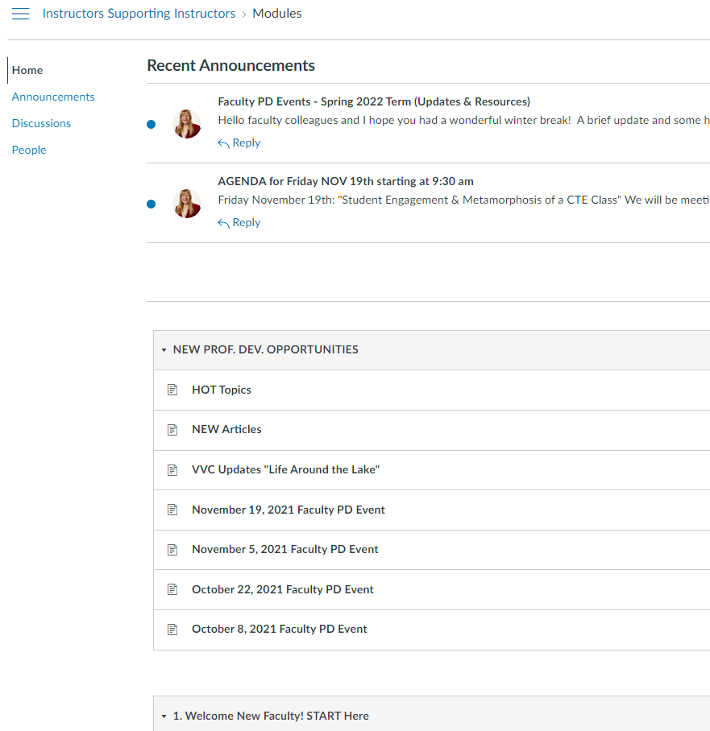
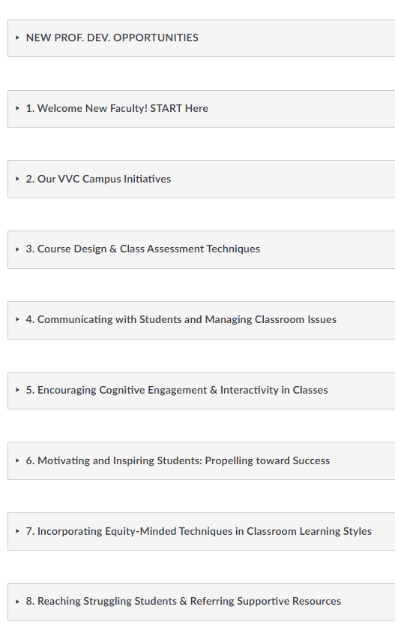


Slide 88
Canvas Topics
7. Incorporating Equity-Minded Techniques in Classroom Learning Styles
8. Reaching Struggling Students & Referring Supportive Resources
9. Promoting Student Academic Integrity / Reducing Cheating & Plagiarism
10. Learning Outcomes, Standards, and Program Review at VVC
11. Professional Development Opportunities Accessible to Faculty
12. Leadership Roles and Responsibilities Available for Faculty
*awaiting your input!
1. Welcome New Faculty! START Here
2. RAM Family: Caring Campus Initiative
3. Curriculum Design & Class Assessment Techniques
4. Communicating with Students and Managing Classroom Issues
5. Encouraging Cognitive Engagement & Interactivity in Classes
6. Motivating and Inspiring Students: Propelling toward Success
This Photo by Unknown Author is licensed under CC BY-SA

Slide 89
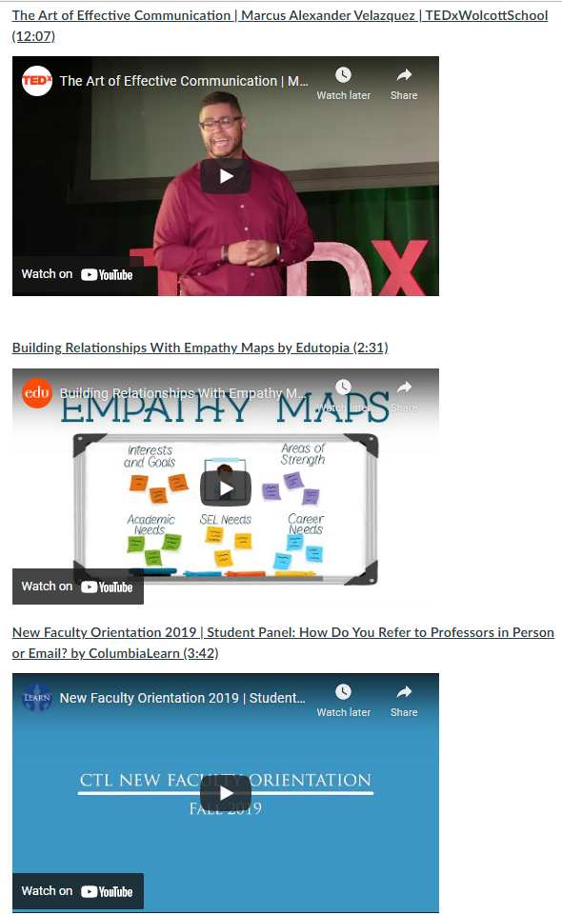
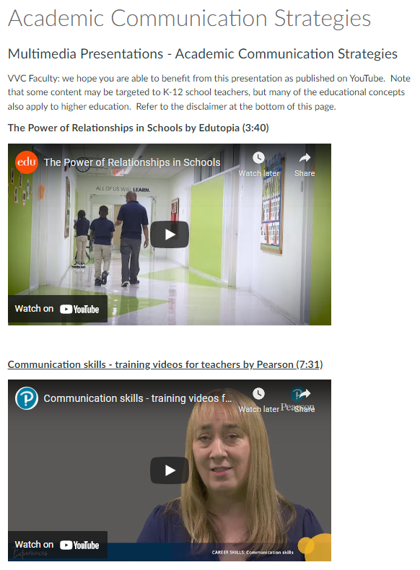

Slide 90

Recommended Books for Faculty
https://vvc.instructure.com/courses/1476/pages/faculty-recommended-book-list
Notes:
This Photo by Unknown Author is licensed under CC BY-NC

Slide 91
Conclusion

Slide 92


Slide 93
Questions?
?

Slide 94
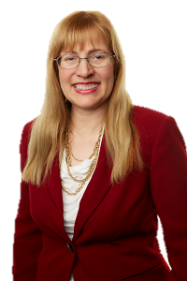
Contact:
Regina Pierce-Brown
Business Real Estate Instructor
Faculty Professional Development Coordinator, 2022-2023
regina.brown@vvc.edu
Regina’s PD Coordinator Office Hours
“Instructors Supporting Instructors”

Slide 95
Faculty PD Events
Comprehensive Guide
2021 – 2022 AY
Victor Valley
College
Victor Valley College Proprietary & Confidential – for Internal Use Only

