Slide 1
Data Governance
Antonio Herrera
Victor Valley College

Slide 2
Data Governance Defined
Data Governance Defined
Data governance is the practice of identifying, organizing, and managing data across an organization. It provides standards and procedures to keep data readily available and usable with data protection to ensure data privacy and data integrity. It is the decision-making function that overlays data management.
The collection of practices and processes that define the use of data are a key part of developing a data governance framework. By defining how data will be used and managed, a data governance framework helps organizations enforce rules that dictate data access and usage as well as provides direction on storage and retention. This is how data management assures optimal availability, usability, integrity, and security of the data across an organization.

Slide 3
What is a data governance framework?
A data governance framework creates a single set of rules and processes for collecting, storing, and using data. By doing so, the framework makes it easier to streamline and scale core governance processes, enabling you to maintain compliance, democratize data, and support collaboration—no matter how rapidly your data volumes grow.
With a data governance framework, you can ensure that your policies, rules, and definitions apply to all your data across your entire organization. You can deliver trusted data to a broad range of individuals in a variety of different roles, from business leaders to data stewards and developers. You can introduce self-service tools that enable even non-technical users to find and access the data they need for governance and analytics. And you can ensure that data is appropriately governed, transformed, and reliably delivered across all applications and analytics deployments in the cloud, on-premises, or both.

Slide 4
Why do I need a data governance framework?
A data governance framework enables the business to define and document standards and norms, accountability, and ownership. In addition to setting out roles and responsibilities, this involves establishing key quality indicators (KQIs), key data elements (KDEs), key performance indicators (KPIs), data risk and privacy metrics, policies and processes, a shared business vocabulary and semantics, and data quality rules.
A data governance framework includes discovery of data to create a unified view across the enterprise. This includes not only the data itself, but data relationships and lineage, technical and enterprise metadata, data profiling, data certification, data classification, data engineering, and collaboration.
A data governance framework supports the execution of data governance by defining the essential process components of a data governance program, including implementing process changes to improve and manage data quality, managing data issues, identifying data owners, building a data catalog, creating reference data and master data, protecting data privacy, enforcing and monitoring data policies, driving data literacy, and provisioning and delivering data.
The business then uses the data governance framework to measure and monitor the results to optimize for trust, privacy, and protection. It tracks processes, data quality, and data proliferation; monitors data privacy and risk exposure; alerts you to anomalies; creates an audit trail; and facilitates issue management and workflow.

Slide 5
What are the pillars of data governance readiness?
The ultimate objective of data governance is to generate the greatest possible return on data (cost of data), capturing critical opportunities to leverage data assets while avoiding the risks of exposing them. These are the critical factors to consider as you assess your data governance readiness and maturity:
People. People collaborate on determining the technology requirements, define the processes, and ultimately drive the data governance outcomes that support strategic drivers. Are your people committed to data governance? Have you formally defined their roles and responsibilities? Do they have the necessary skills? Have you developed a change management plan, including sponsors, to support organizational alignment and buy-in?
Processes. Data governance processes allow people to confirm that your data is formally managed across the enterprise, which ensures that your critical business processes draw on trusted data. Are your data definitions, rules, and goals realistic and appropriate? Are your business processes modernized and your business rules reviewed so that they can integrate data governance cleanly and deliver meaningful results?
Contributors: Business and IT subject matter experts who provide necessary context, including business leaders, process owners, and stewards who run the upstream and downstream processes impacted by your initiative, as well as IT architects, analysts, and systems experts
Technology. Technology includes the platforms, tools, and subject matter expertise necessary to enable a sound data governance process. Even if your existing systems are already governed to some extent, platform technology enablers such as data profiling, lineage, and metadata tools are critical to your ability to automate and scale your data governance processes and accelerate time to value.

Slide 6
Modern Approach
Empowers people with a balance of access and guidance.
An effective data governance program must start with, and center around, the people
Lack of focus on business impact
Prolonged, expensive, and document-centric
80% of data governance Initiatives fail: Gartner correlates failure of data governance programs with organizational inability to align with digital business outcomes.
Formalizes what already exists – The path to data governance has been misrepresented as a long, expensive journey. In reality, most data consumers at large organizations are already governing data informally.

Slide 7
Modern Approach
Actively guides people to govern data – focus on guiding the people as the means to governing the data. This contrasts with legacy approaches that focus on simply documenting data and policies.
Guiding people’s behavior is accomplished by embedding governance policies, standards, and terms in data consumers’ normal activities, workflows, and tools. Users have immediate access to these as a guide while searching, using data, and contributing to the corpus of knowledge.
Notes:
Collaborative, not bureaucratic – A governance approach empowers
employees to participate in a community where they are rewarded for sharing
their knowledge and input.
Experts can record their expertise in wiki-like articles around a specific asset,
or offer guidance in saved conversations.
In this way, the data catalog delivers value to the employee population at large
as opposed to concentrating the power of stewards or IT – and granting
outsized control to the few over the flow of knowledge to the many.

Slide 8
Modern Approach
Key Characteristics The differentiating characteristics of this methodology are:
Pragmatic, not theoretical
Business-centric
Continuous Improvement
Intelligence
Incremental, not ‘big-bang’, implementation
Community driven, not committee controlled
Guided, not gated, participation
Employee value, not steward & IT centric value
Data usage, not documentation
Notes:
Pragmatic, not theoretical – What’s the starting point for “what to
govern”? The reports used monthly, quarterly, and annually to run
the business. By definition, those reports contain the most important
business metrics and are supplied from the most important data
sources. The most impactful governance activities will maintain
and improve the completeness, quality, and accuracy
Business-centric - governance approach begins with
business content and requires business ownership. Executive buy-in
will sustain a high level of quality that delivers value to the entire
employee population. This is beyond participation in a program
that is led by IT, but ownership of the process itself as supported
by IT.
Continuous Improvement – Data is always changing and degrades
at a predictable rate. Given this truth, data governance is not a “one
and done” process. It includes a feedback loop that prioritizes people’s
efforts based on targets and measurements to maintain high-quality
metadata. This people-centric process ensures data is always
improving and ready for analysis and modeling. In this process of
continual improvement, data can be continuously refined, so it is
always ready for analysis and modeling.
Intelligence – Machine learning can automate the most tedious
processes around data governance, scaling governance across
the enterprise. Machine learning can support more autonomous
stewardship and eliminate the drudgery of data stewardship, including
the discovery of data steward candidates. Stewards have busy day jobs,
so eliminating much of the work of data stewardship is transformative.
Incremental, not ‘big-bang’, implementation – governance
approach focuses on repeating a successful pattern of implementation
across business areas. This enables the rapid delivery of value to the
business, and for decisions to be made about incremental investment
based on proven success.
Community driven, not committee controlled – governance
approach empowers employees to participate in a community where
they are welcomed and rewarded for collaborating, and sharing their
knowledge and ideas.
Guided, not gated, participation – governance approach
is rooted in the belief that people want to do a good job and will
follow guidelines for participating and contributing when trained.
It is therefore in the greatest interest of the organization to not use
the role of steward to block participation or meter the flow of content,
but to instead act as mentor and coach, guiding and helping people
do things correctly.
Employee value, not steward & IT
centric value – governance
approach focuses on delivering value to
all employees, not creating a mechanism
to drive value to stewards or IT alone by
enabling them to have complete control
over the flow of knowledge.
Data usage, not documentation – governance approach
goes far beyond simply documenting and creating glossaries.
It integrates the governance policies, standards, and terms, with
access to data, queries, and reporting. This embeds governance
at the point of access, making it an active and natural part of the
work activities for analysts and users.

Slide 9
Active Governance Process
Establish Governance Framework - The data governance process
requires that some things be decided in advance; namely, what will
be governed, how it will be governed, and how success or failure
will be measured. These represent target commitments that are
expressed as policies and standards. Policies and standards should
define completeness, quality, accuracy, timeliness, usage, access and
classifications for both metadata and data.

Slide 10
Data Catalog
Populate Data Catalog - Governance requires knowledge and content. Historically, this knowledge has been gathered by assembling
experts (stewards and SMEs) to identify key business assets on a onetime basis. The complexity and ongoing transformation of a modern
enterprise makes this approach unsustainable. Approach has the organization identify key assets so that their metadata can be ingested and analyzed. This process translates technical labels into human ones, giving understandable names to abbreviated and critically named data assets. As a goal, Business Stewards should be able to consistently and easily measure the gap between the governance standards and existing performance. This gap perpetuates an active cycle of assignment and continuous curation.

Slide 11
Data Business Stewards
Empower Business Stewards - As implementation of governance
begins for each business area, it’s critical to recognize and identify
business stewards. Generally, stewards sit inside the business area
and play a critical role in driving awareness, onboarding, moderating
and guiding participation. They are accountable for ensuring the
targets in the policies and standards are maintained. Historically,
governance teams have tasked stewards with primary responsibility
for this enforcement work – they are the so-called policy enforcement
officials of data.

Slide 12
What are the pillars of data governance readiness?
A data governance framework directs how data will be managed and controlled. Among the areas commonly included in data governance frameworks are data policies, such as:
Data availability, Accessible and ready for easy consumption.
Data integrity/Risk Management, Data qualities are retained, across different platforms, regardless of how it is stored, converted, transferred, and viewed.
Data quality/measurement, Ensures data is correct, consistent, and cleaned.
Data security, Safeguards are in place, including classification according to its sensitivity and storage policies and procedures that ensure data protection.
Data usability, Clearly structured, documented, and tagged.
Cost Minimization
Data warehousing

Slide 13
Data Governance Roles
You need to put the right people in place to support, sponsor, steward, operationalize, and ultimately deliver a positive return on your data.
First and foremost, you need an executive steering committee or data governance council. This group communicates, prioritizes, funds, resolves conflicts, and makes decisions about data governance for your entire enterprise. The steering committee is made up of the executive leaders of your organization. Sometimes they belong to the C-suite; they may also be vice presidents or directors accountable for the specific lines of business.

Slide 14
Data Governance Roles
An effective data governance program should include the following roles in addition to the high-level people on your executive steering committee:
Executive sponsor. This is the C-level executive whose responsibilities span functional, line-of-business, application, and geographic silos. Identify your sponsor early, because this person allocates resources, determines staffing and funding, identifies high-priority business issues, and fosters cross-functional collaboration.
Data stewards. Data stewards are the business and IT subject matter experts (SMEs) who translate how your data governance framework affects your organization’s business processes, decisions, and interactions. Business stewards must be IT-savvy. Likewise, IT stewards must understand the business. Experienced business analysts capable of acting as communication bridges between business and IT can make the best business stewards, while data and enterprise architects and senior business systems analysts make strong IT stewards.
Data governance leader. This person coordinates tasks for data stewards, helps communicate decisions made by stewards to relevant stakeholders, drives ongoing data auditing and metrics that assess program success and ROI, and is the primary point of escalation to the executive sponsor and steering committee.

Slide 15
Data Governance Technology
In the context of data governance, “technology” primarily means automation. Many technology solutions and platforms exist to help you automate different aspects of data governance, traditionally completed manually. But you must consider the full lifecycle of critical enterprise data, from creation to archival, when choosing technology to support your data governance efforts.

Slide 16
Data Governance Technology
You should also focus on intelligent automation. Intelligent automation possesses four key qualities:
Scale: New data types and sources are always emerging. The huge and growing volumes of enterprise data need to be assessed, curated, and protected so that anyone or any system can use them. The technology chosen for data governance needs to continually govern more data from more sources and handle more user requests without trouble, scaling up to the largest cloud data lake.
Extensibility: Modern data governance isn’t just about documentation and compliance. It delivers measurable value for the entire organization. Intelligent automation thus goes well beyond data governance project management to deliver a fully integrated platform for data management that includes data quality, data privacy, data cataloging, and stewardship capabilities.
Agility: An intelligent automation solution enables you to get started quickly without massive and costly custom integration efforts. and the flexibility within a proven intelligent data governance solution will also allow your organization to react swiftly to new regulations, new business models, or new competition
Automation: Leverage the power of artificial intelligence (AI) and machine learning to reduce redundancy and free up the time of data professionals—especially data stewards and your data operations team—and allow them to focus on more important matters.

Slide 17
Data Governance Policy
Business policies and standards are critical for any data governance program. You need to agree on policies that span the enterprise rather than be confined to a particular line-of-business or departmental silo.
Typical policies include data accountability and ownership; organizational roles and responsibilities; data capture and validation standards; information security and data privacy guidelines; data access and usage data retention; data masking; and data archiving policies.
With the culture at each organization being different, there isn’t a right or wrong set of policies to consider as you map out your data governance program. The one area to watch out for, however, is to steer clear of being considered overbearing with red tape. Successful data governance today should focus their policy and procedure decisions more on collaboration than on control. Decide together on what’s best for the organization while also understanding that enforcement doesn’t have to feel restrictive. By making this pivot, you will shift your data governance program from being policy centric to value centric.

Slide 18
Stakeholders in the Data Governance Framework
Including stakeholders in data governance framework development is crucial. These stakeholders should represent the different areas and functions within an organization. Stakeholders vary based on the structure of the organization and use cases, but generally fall into a few categories:
Data governance
Privacy and compliance
Functional areas (e.g. Finance, Student, Fin Aid, HR, Website content) and lines of business
Analytics and data science

Slide 19
Compliance
HIPAA
FERPA
PII
California/CCC standards
The Web Content Accessibility Guidelines (WCAG), also Disabilities Act (ADA) Section 508 standards
PCI https://www.pcisecuritystandards.org/
FBI Compliance
GDPR https://www.alastore.ala.org/content/information-law-compliance-librarians-knowledge-managers-and-information-professionals

Slide 20
References
NIST Special Publication 800-100 Information Security Handbook: A Guide for Managers Recommendations of the National Institute of Standards and Technology
NIST 800-37r2 Risk management framework for information systems and organizations: a system life cycle approach for security and privacy
NIST 800-53r5 Provides a baseline of security and privacy controls. Security and Privacy Controls for Information Systems and Organizations
NIST 800-171r2 Enhanced Security Requirements for Protecting Controlled Unclassified Information (CUI)
https://www.techrepublic.com/article/data-management-a-cheat-sheet/
Egnyte: Data Governance Framework: Four Pillars for Success
Alation: Active Data Governance: Using a people-first approach to avoid failed governance programs
Carnegie Mellon University:https://en.wikipedia.org/wiki/Capability_Maturity_Model_Integration

Slide 21
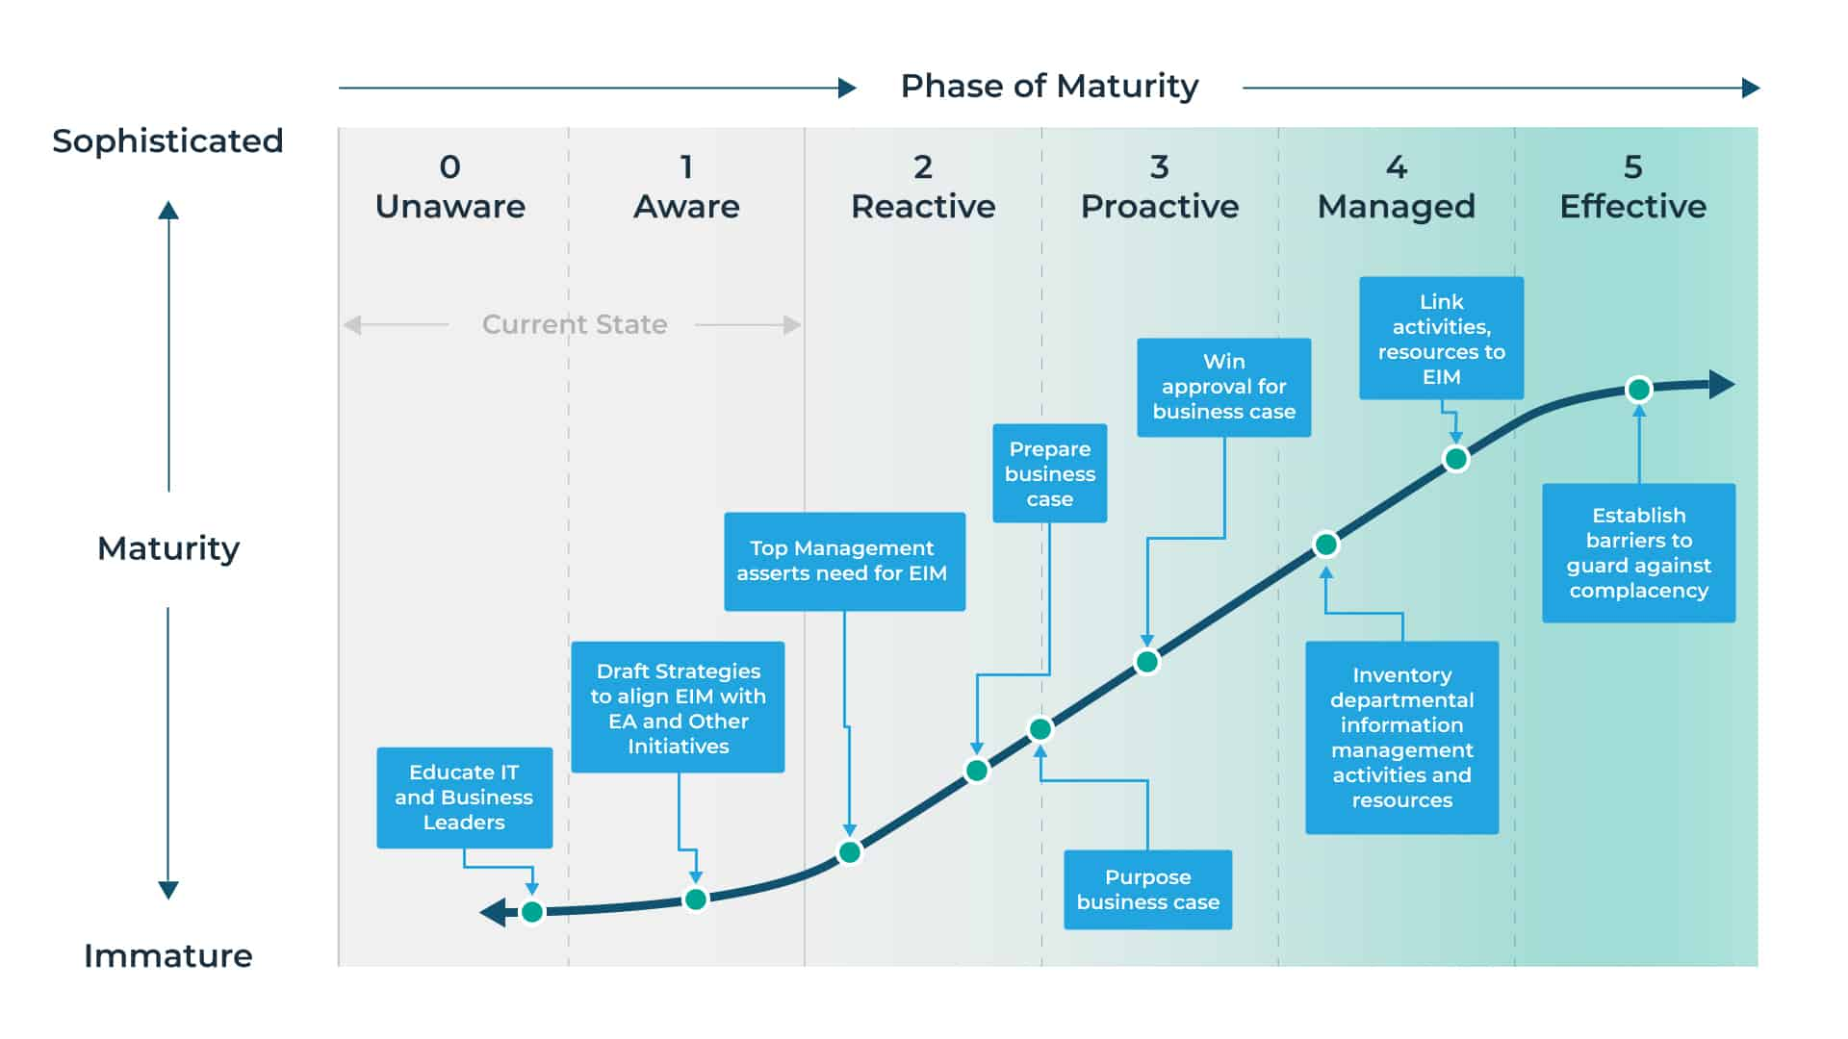

Slide 22
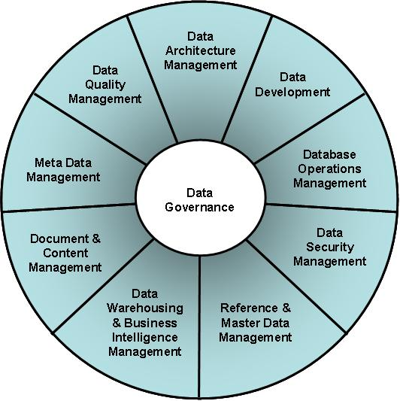

Slide 23
